Slide 1

Accounts Receivable
project

Slide 2
TEAM MEMBERS
Evon Nady Thabet Morcos
Mohamed Khaled Mohamed
Mahmoud Mohamed Abdalhaliem
Yossra Ahmed Hosny
Ziad Mohamed Fathy
Asmaa Mohammed Hussien
Group Code: NXT14_ONL2_ERP4_S2
Under Supervision: ENG.Ahmed Elzahed
Company Name: Next Academy

Slide 3
PAYMENT TERMS

Slide 4
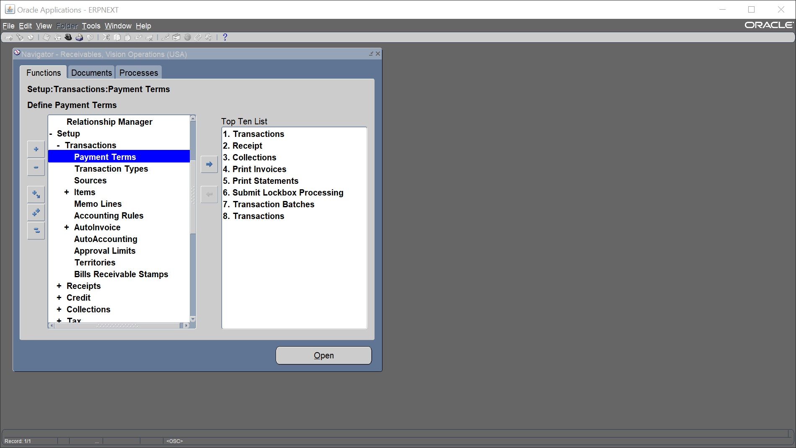
Payment Term
Setup
Transaction
Payment Term

Slide 5
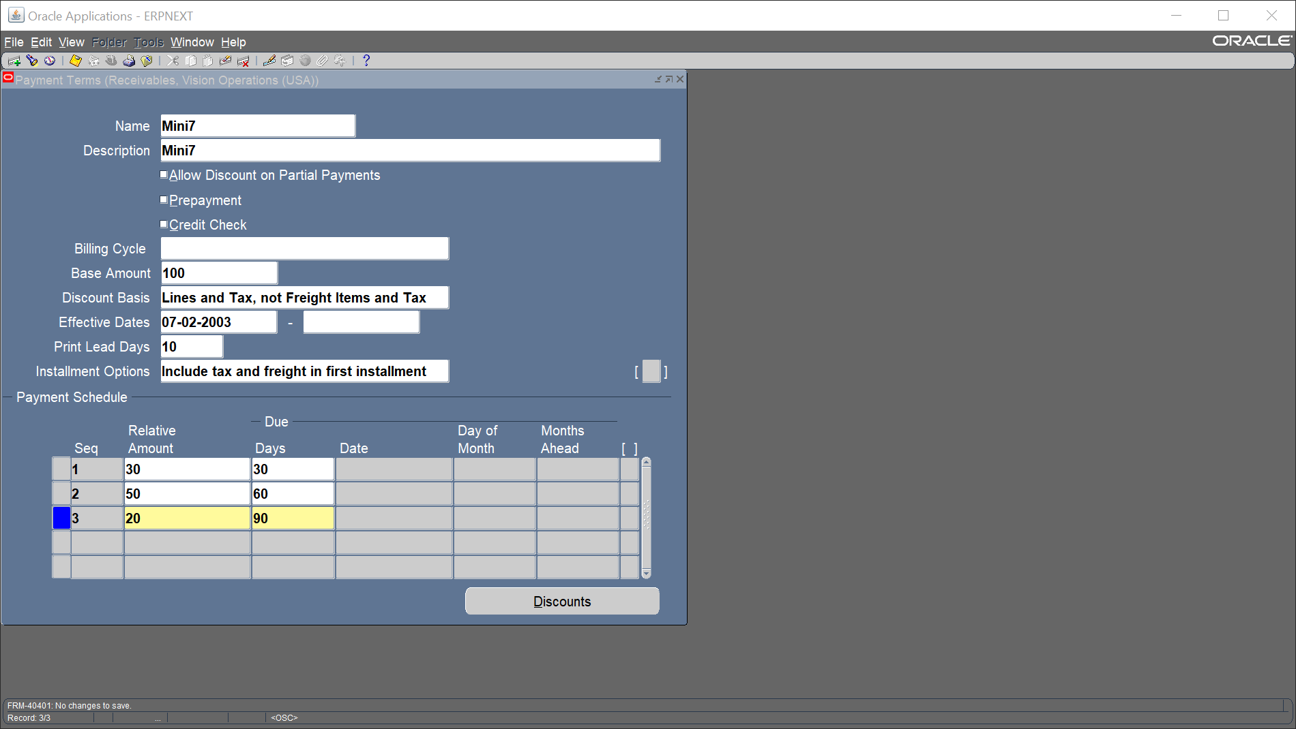
Add our name, description, base amount and our payment schedule

Slide 6
Create Manual Customer

Slide 7
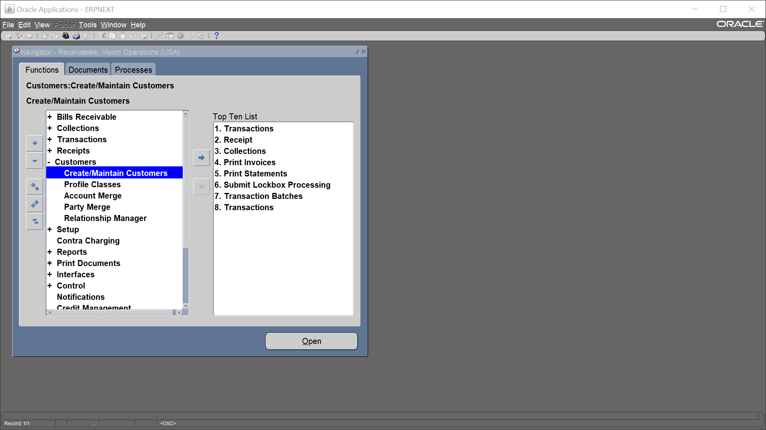
Create Manual Customer
Receivable Vision Operations (USA)
Customers
Create /Maintain Customer

Slide 8
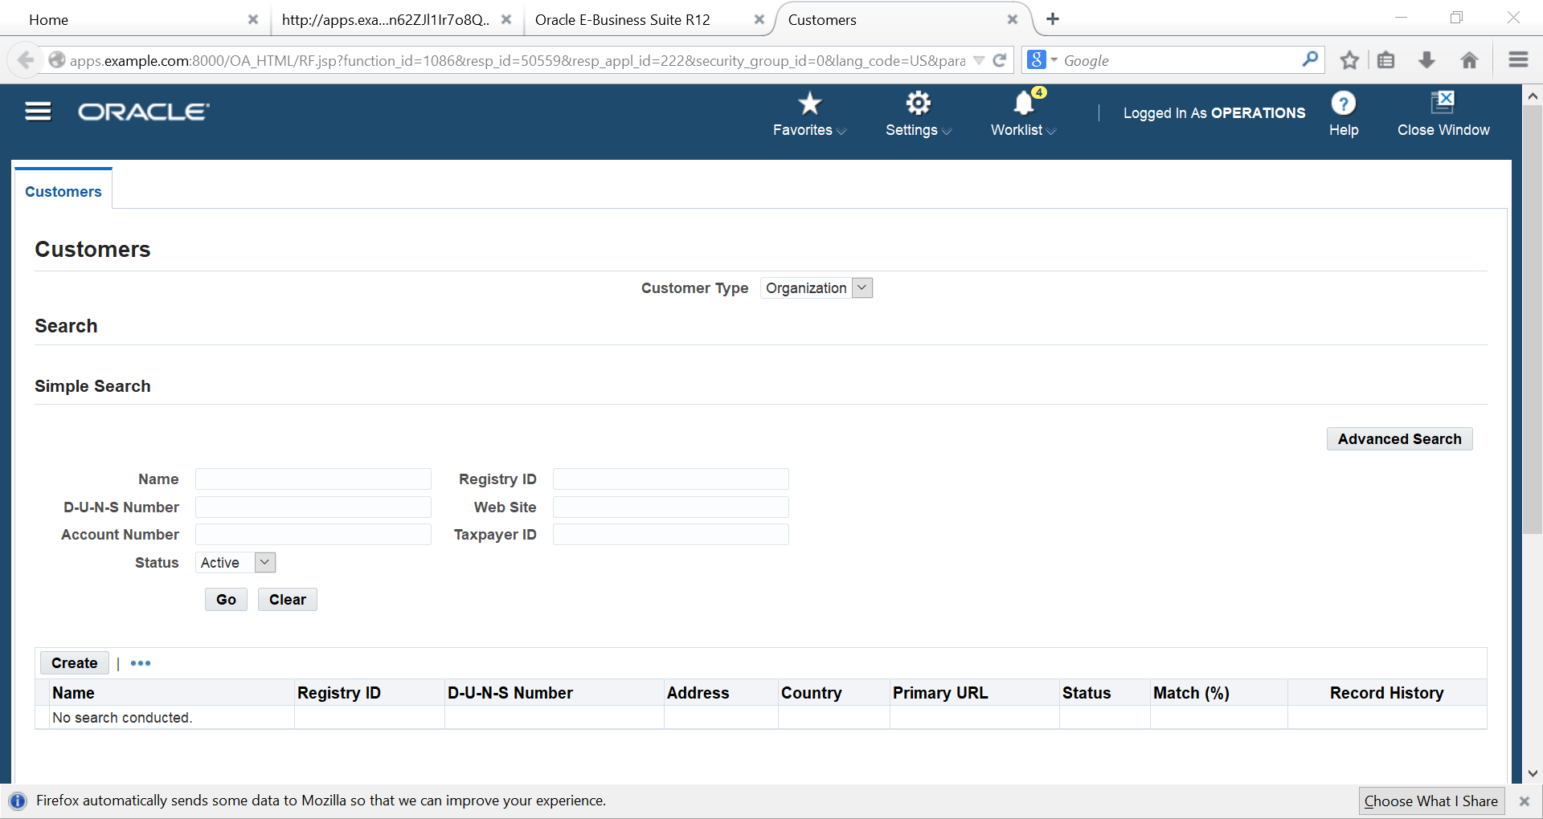
Create

Slide 9
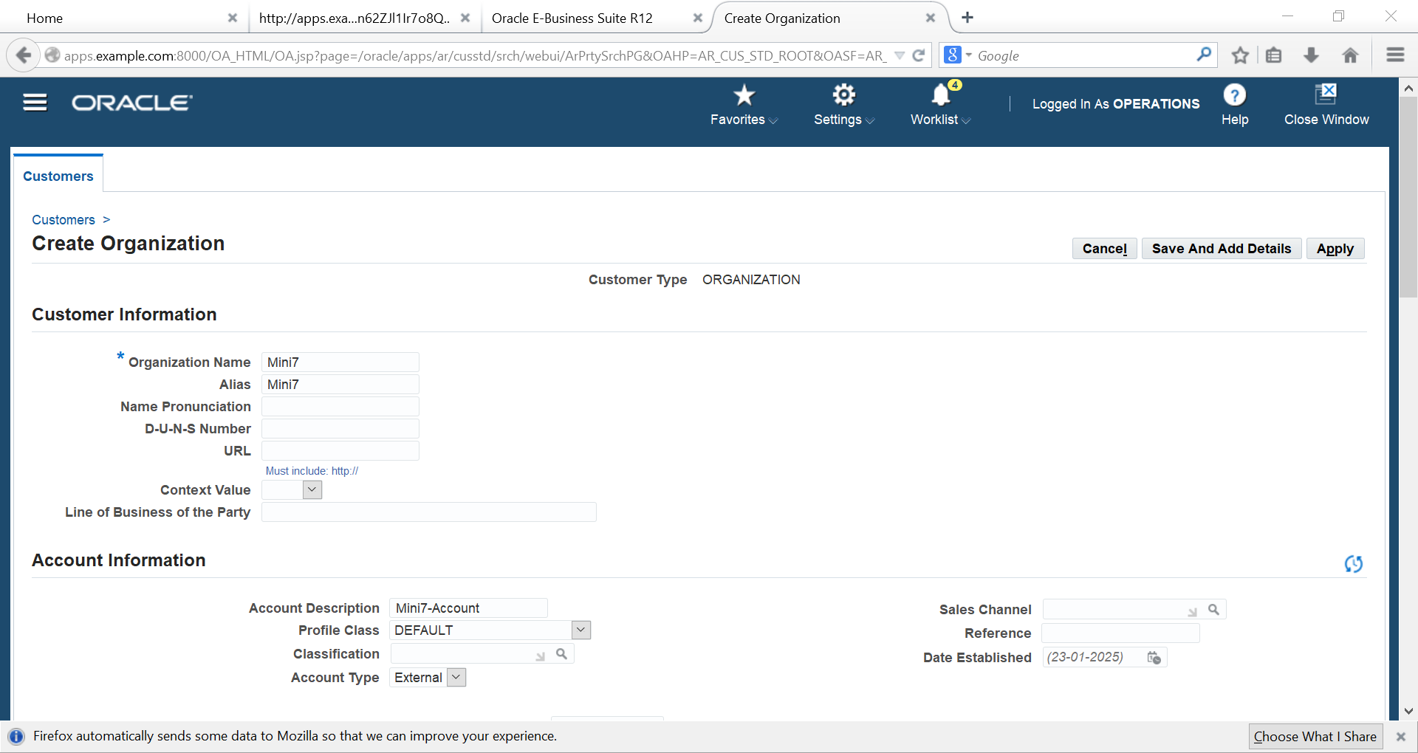
Add Name, Alias

Slide 10
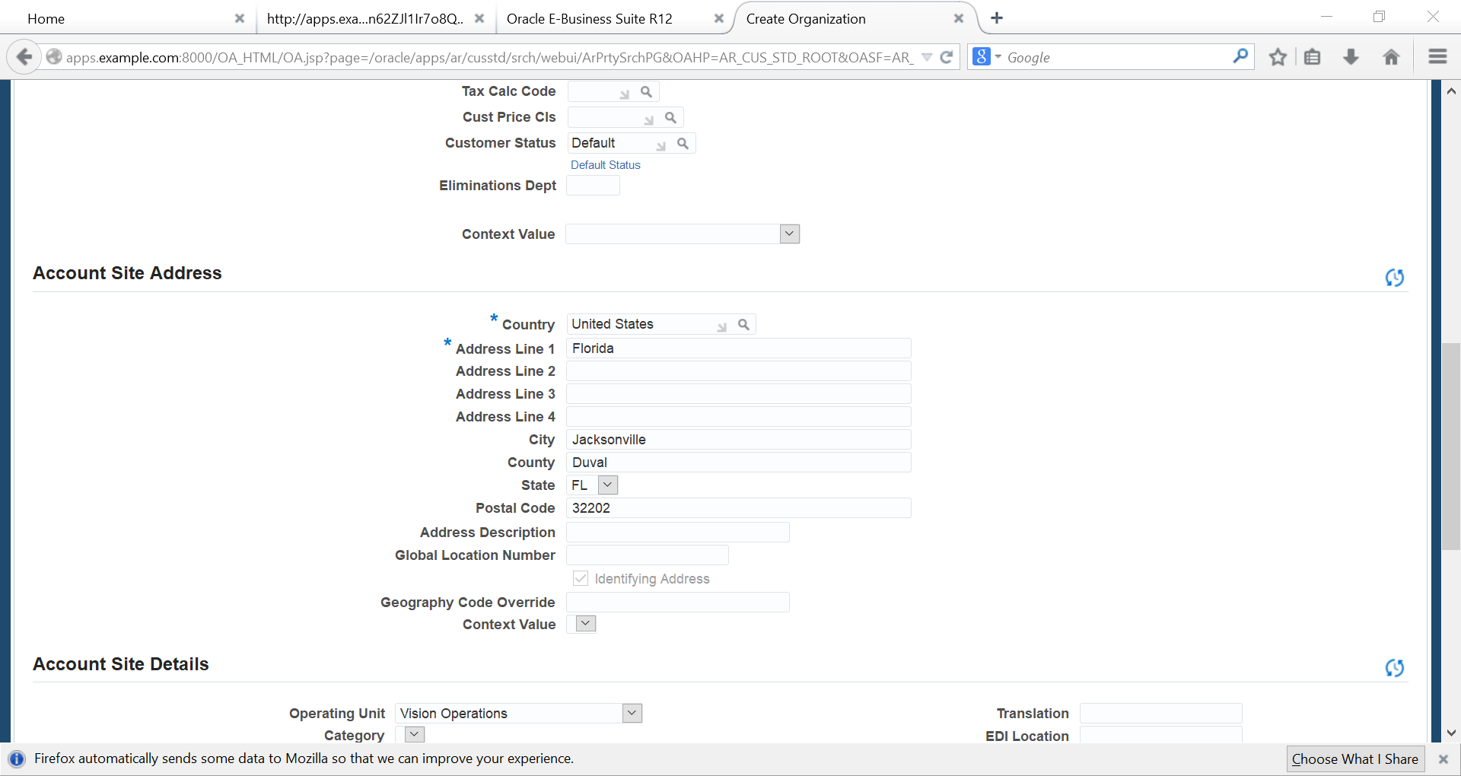
Add Country, Address, City, County, State, Postal Code

Slide 11
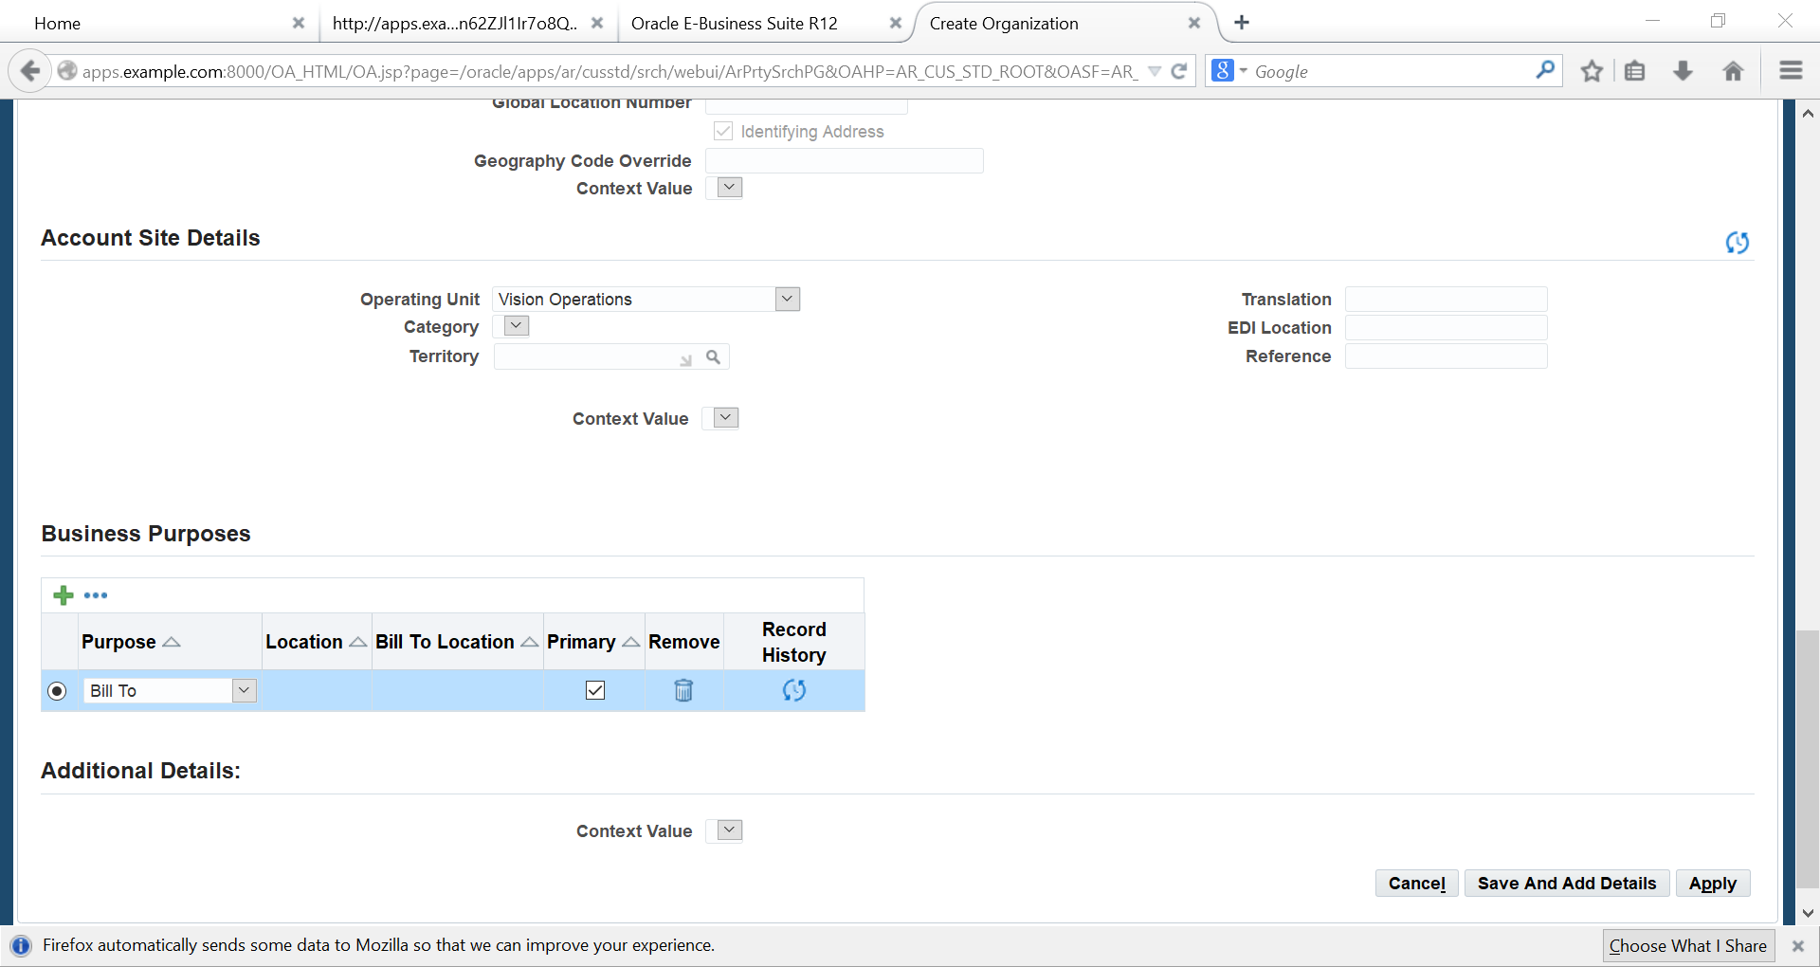
Primary, Apply

Slide 12
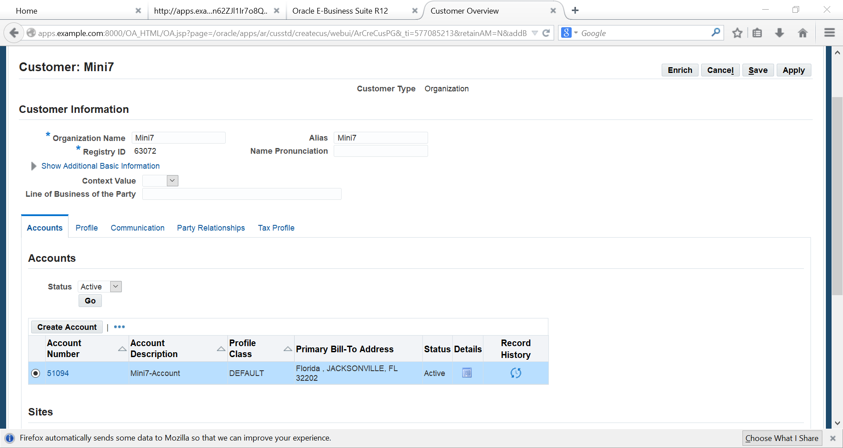
Choose our CUSTOMER

Slide 13
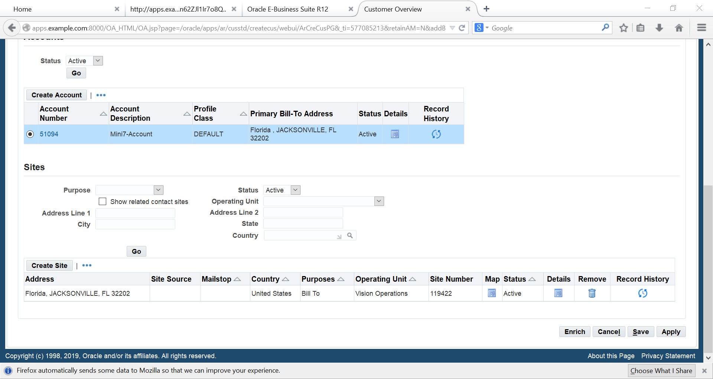
Click Details

Slide 14
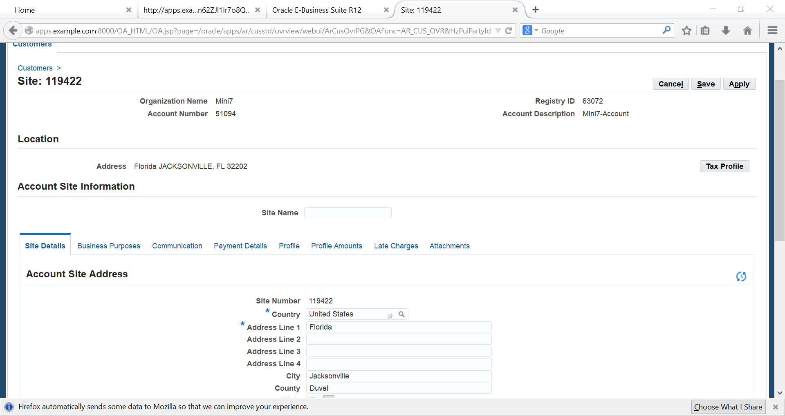
Business Purposes

Slide 15
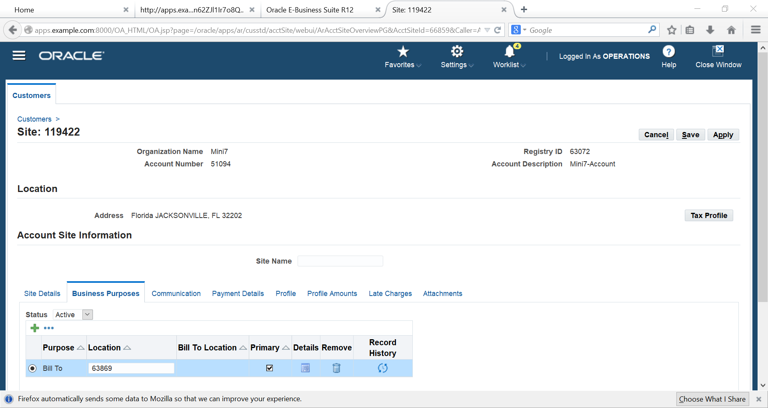
Detail

Slide 16
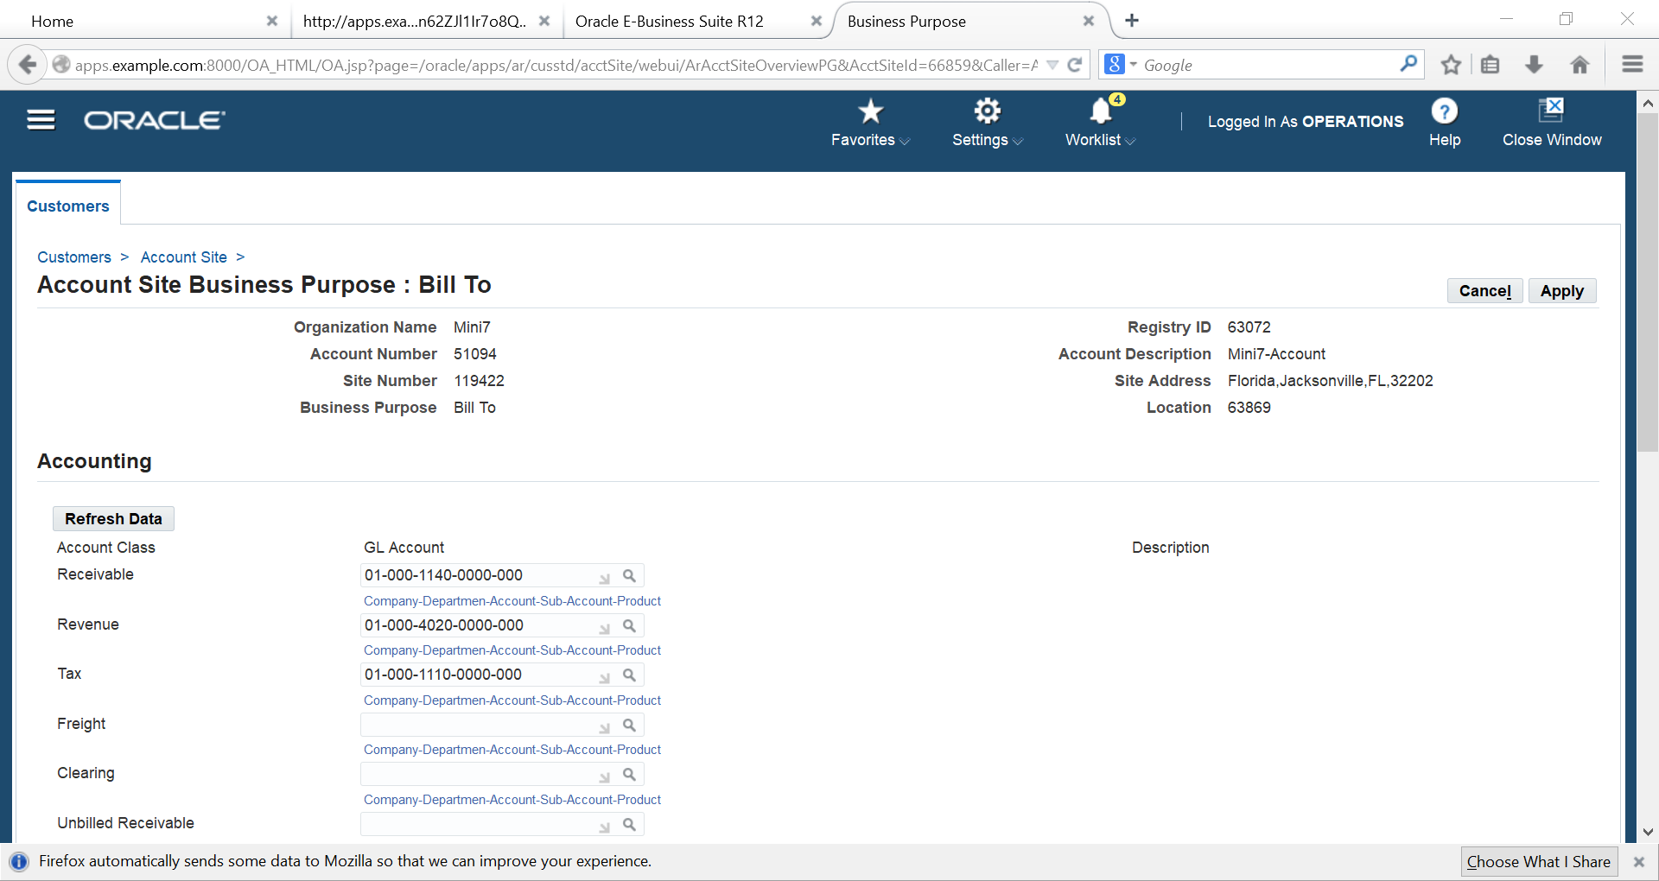
Adding accOUNT receivable, revenue and tax

Slide 17
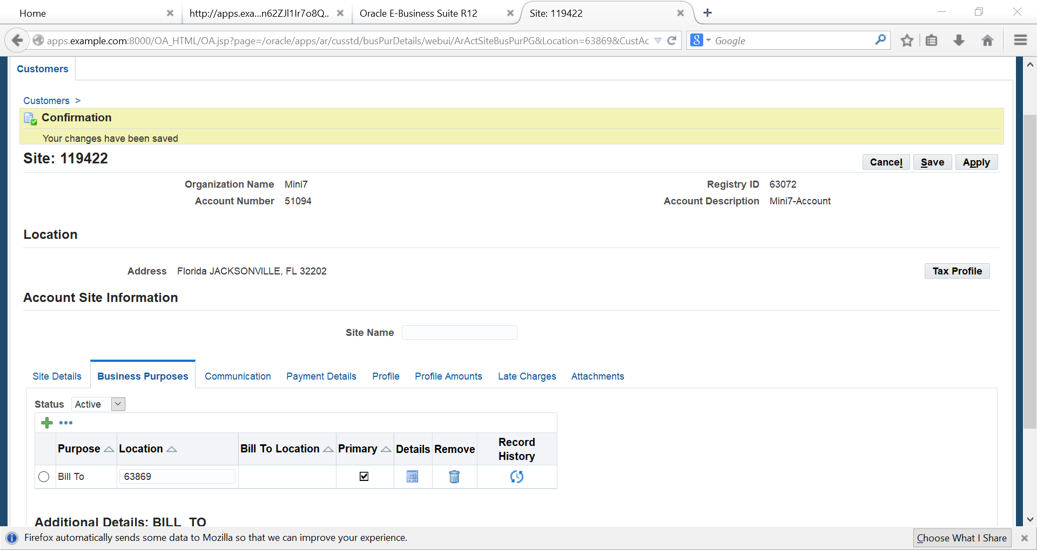
Tax Profile

Slide 18
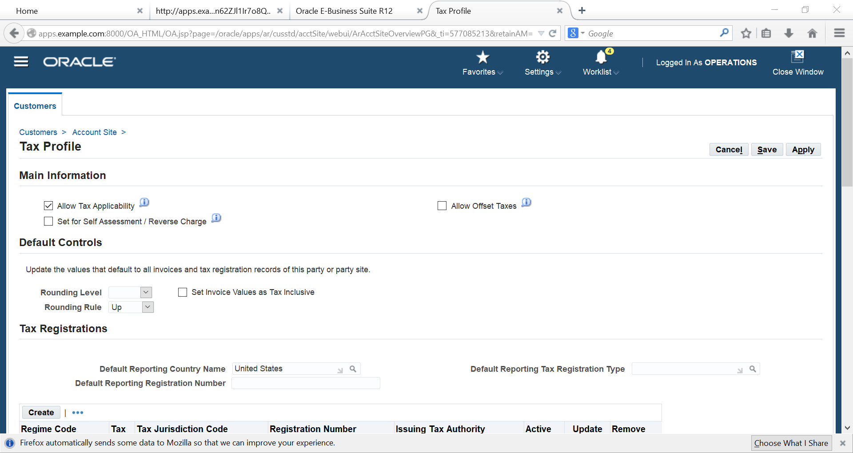
Allow Tax Applicability

Slide 19
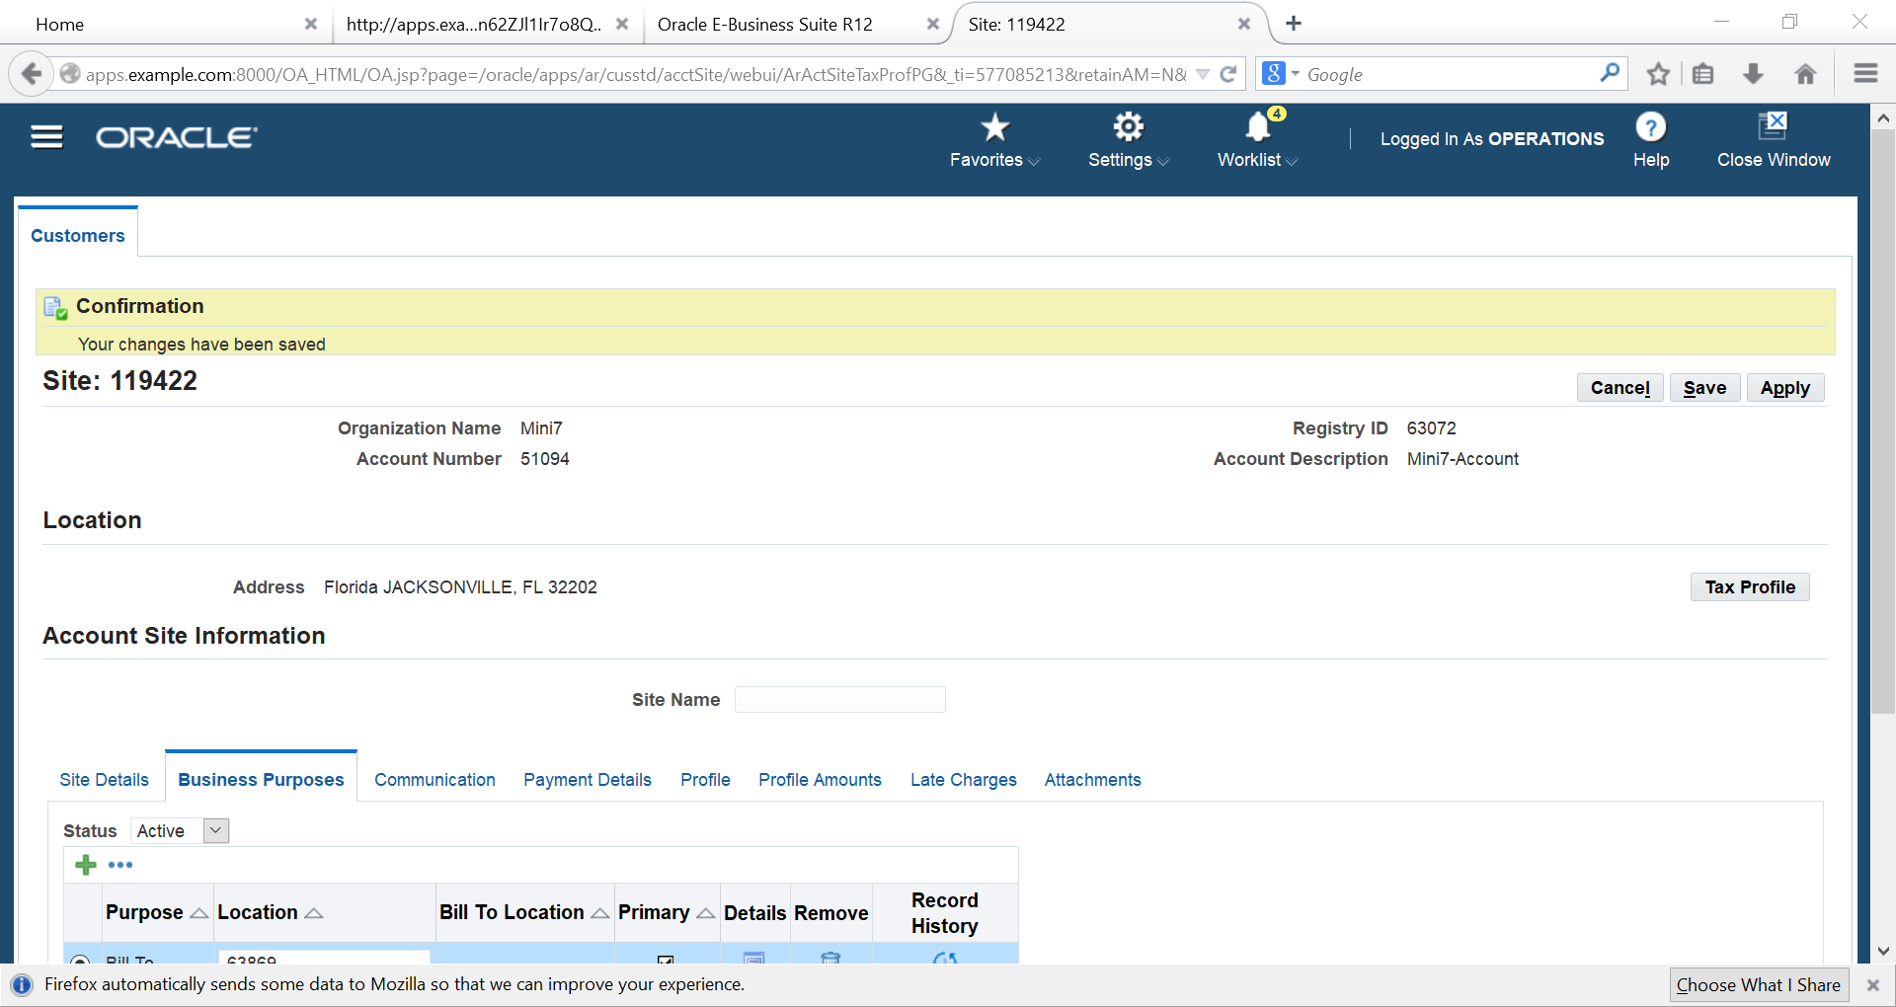
Profile

Slide 20
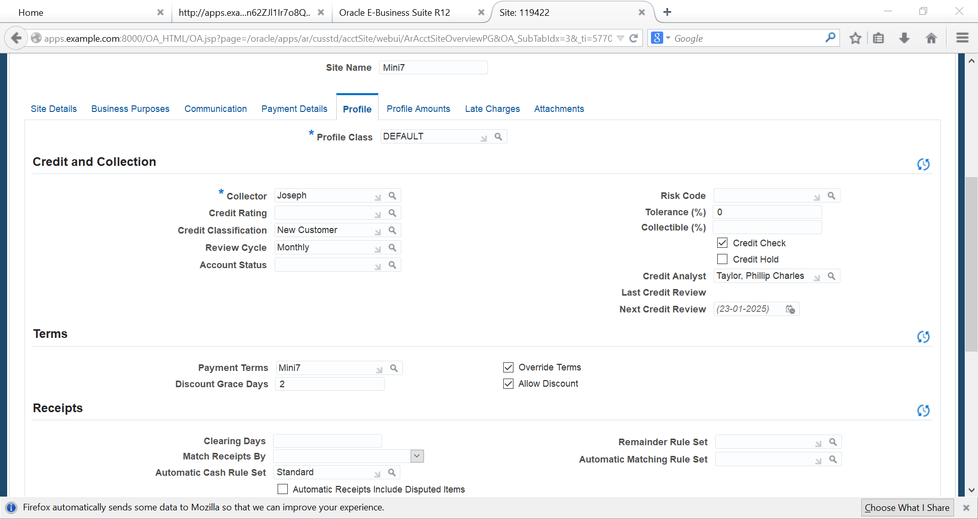
Choose our payment term

Slide 21
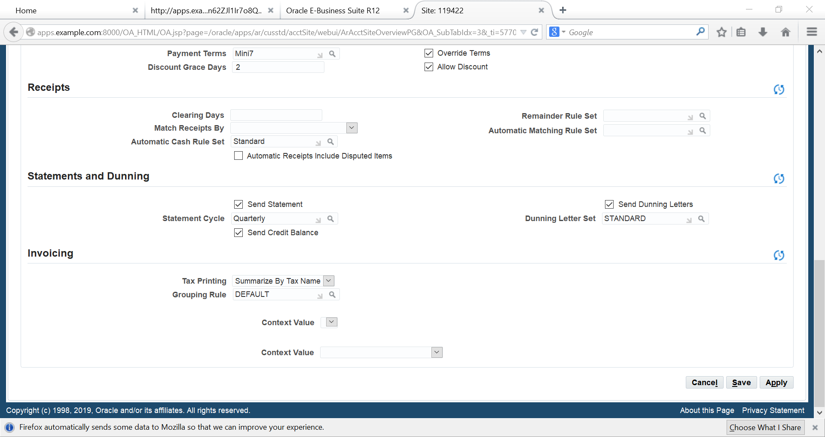
Click apply

Slide 22
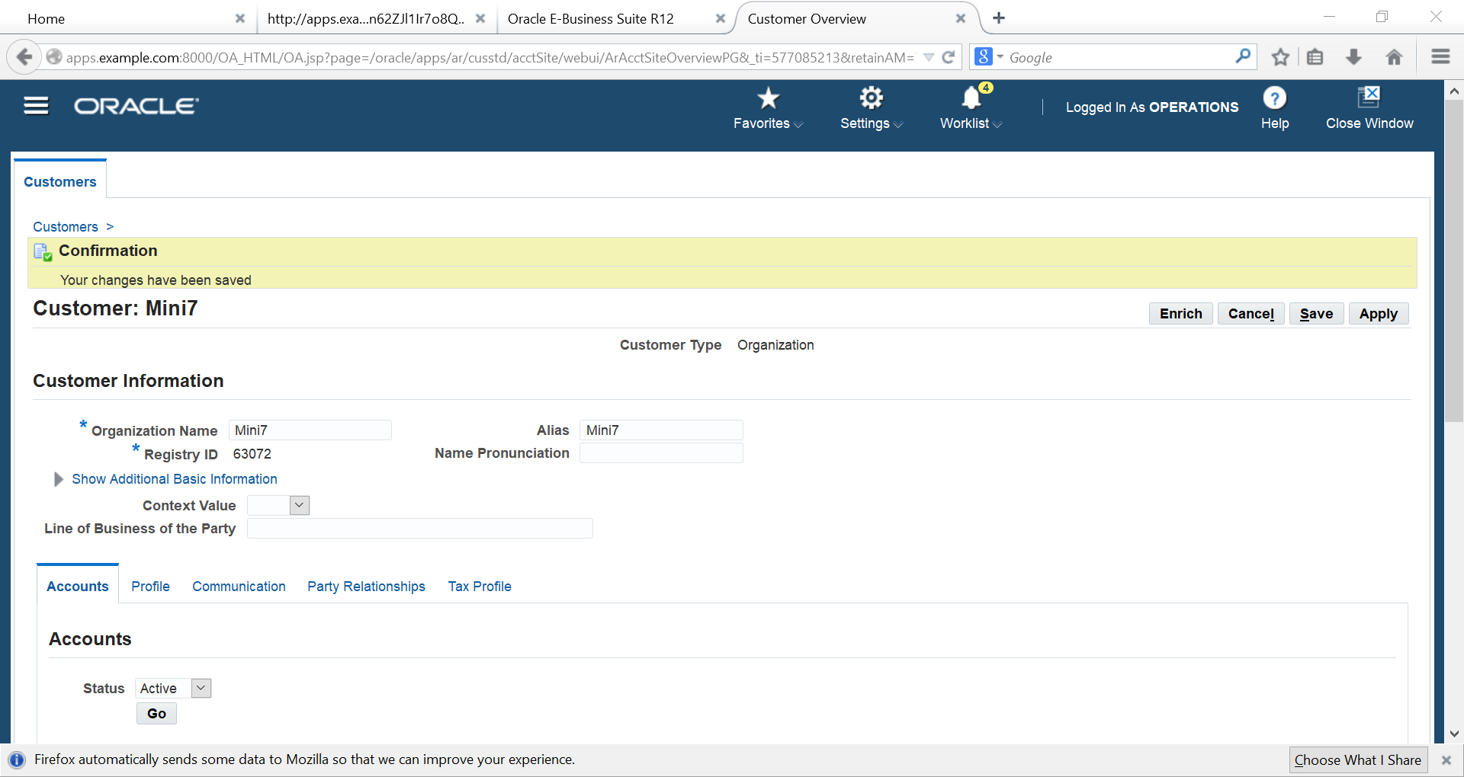
Here is our customer account & site

Slide 23
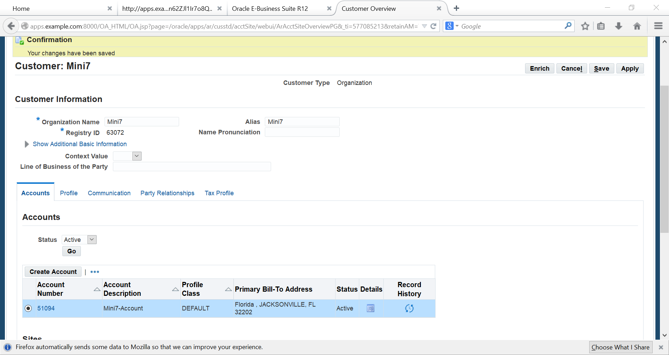

Slide 24
MEMO LINE

Slide 25
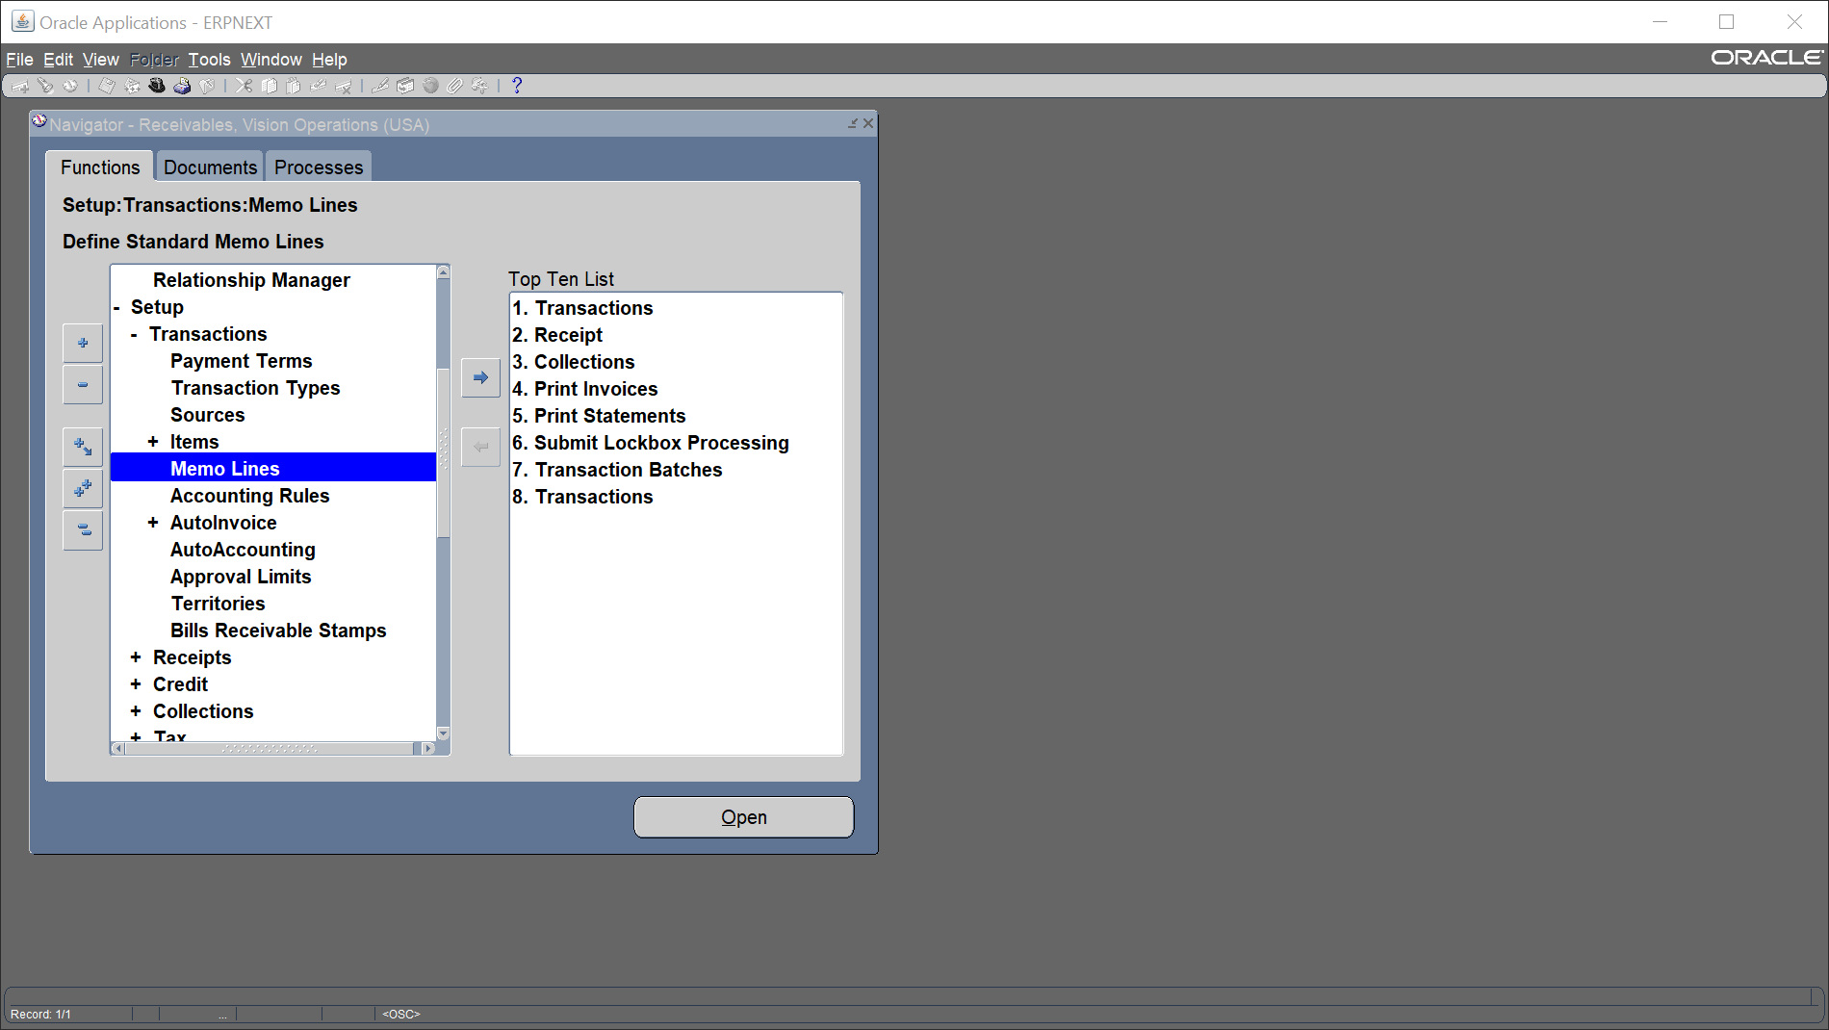
Memo Line
Setup
Transaction
Memo Lines

Slide 26
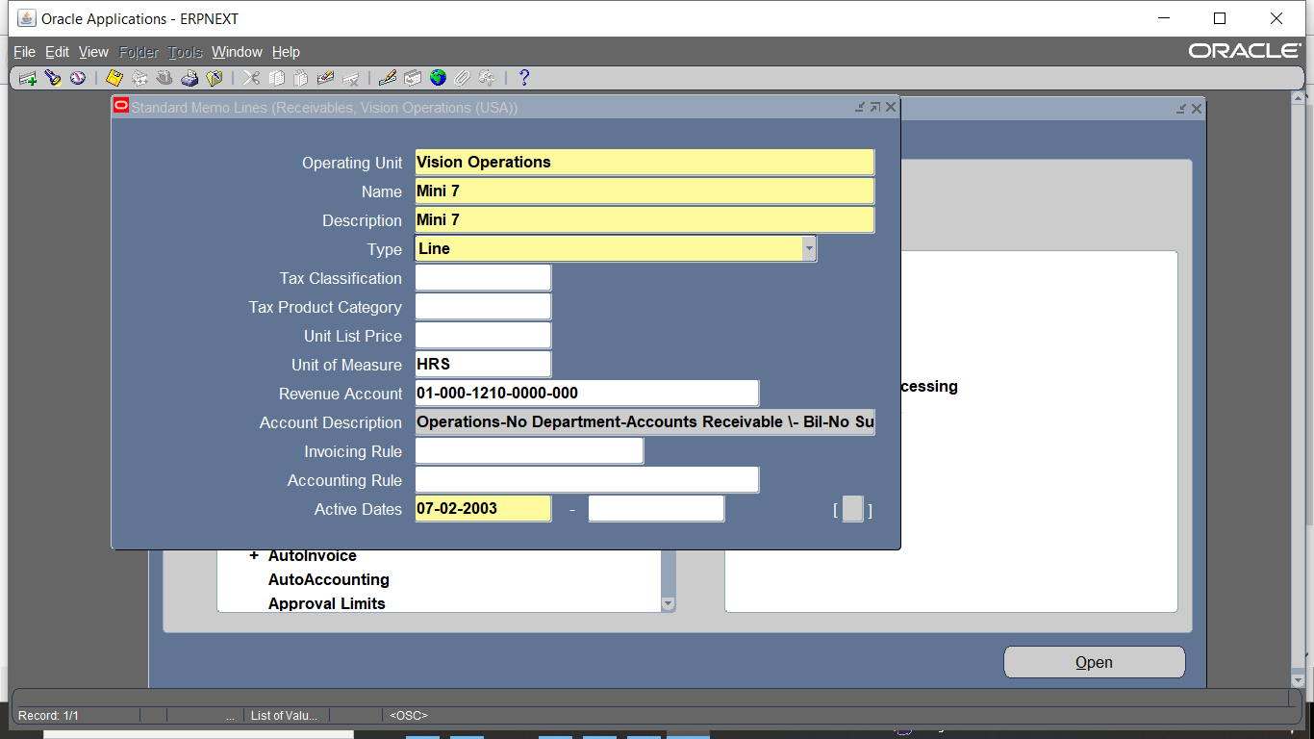
Add name . Description, Revenue ACC, active dates

Slide 27
Making invoice

Slide 28
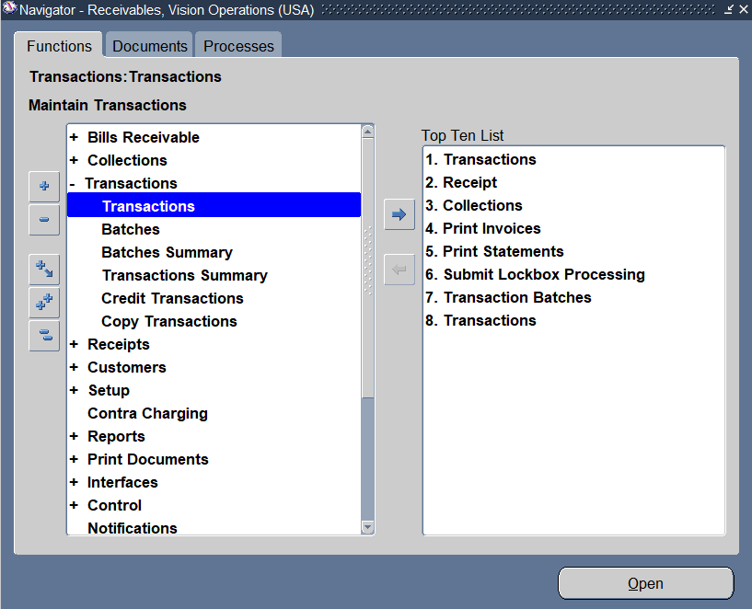
Making invoice
Transactions<<< Transactions

Slide 29
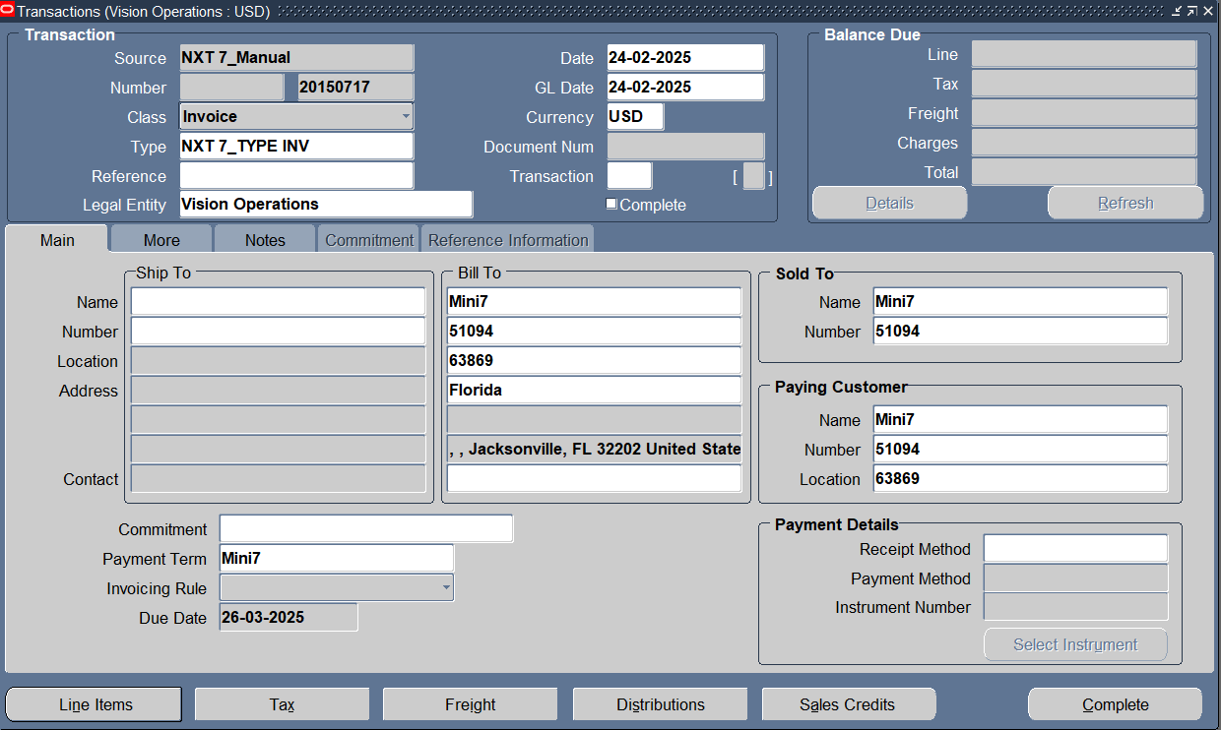
Enter Customer Info ,transaction class its type & tap line items to add transaction line

Slide 30
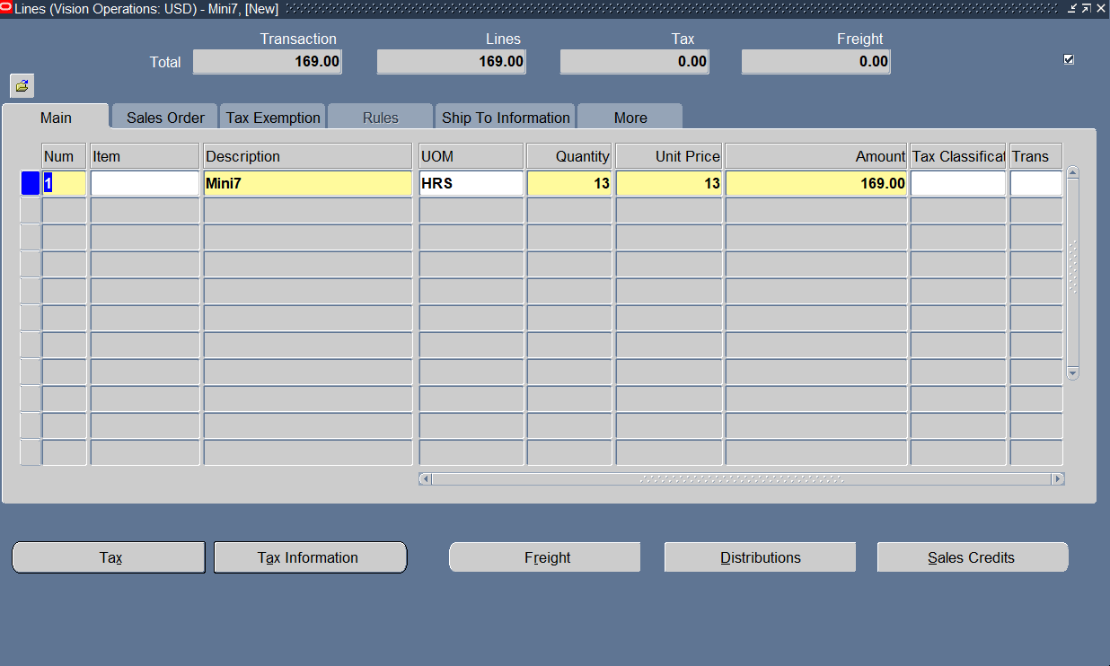
Add Transaction Line

Slide 31
Complete this transaction

Slide 32
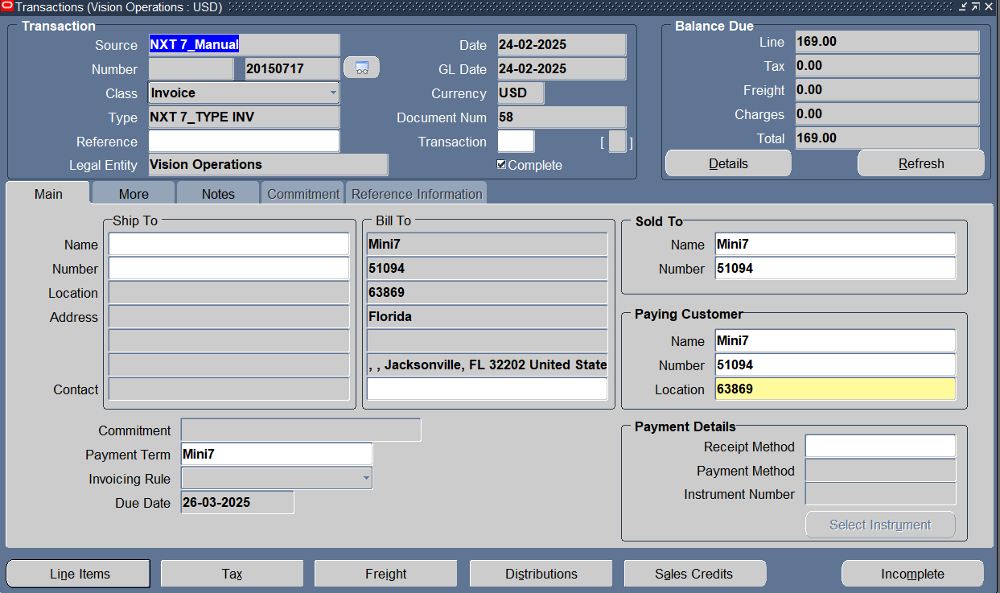
Transaction entry completed & we have a transaction number

Slide 33
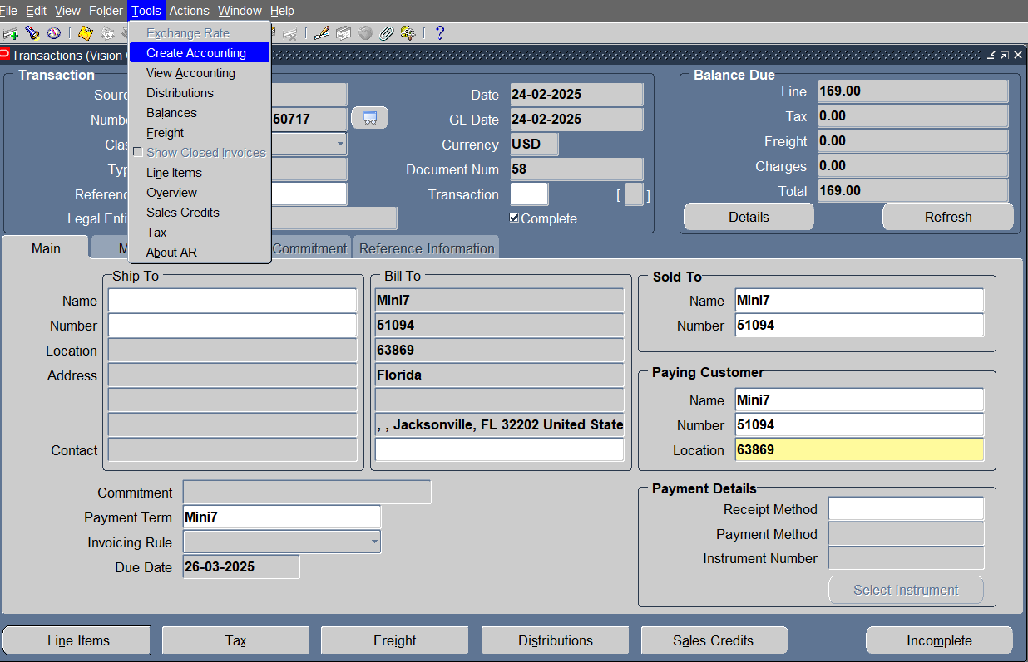
Creating accounting treatment

Slide 34
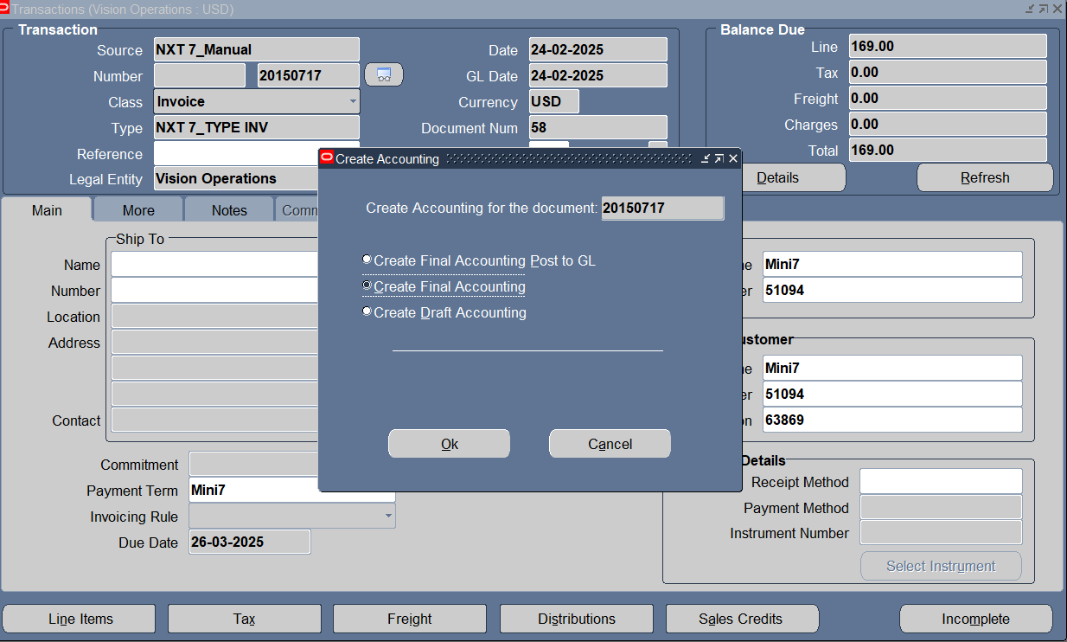
Create Final Accounting

Slide 35
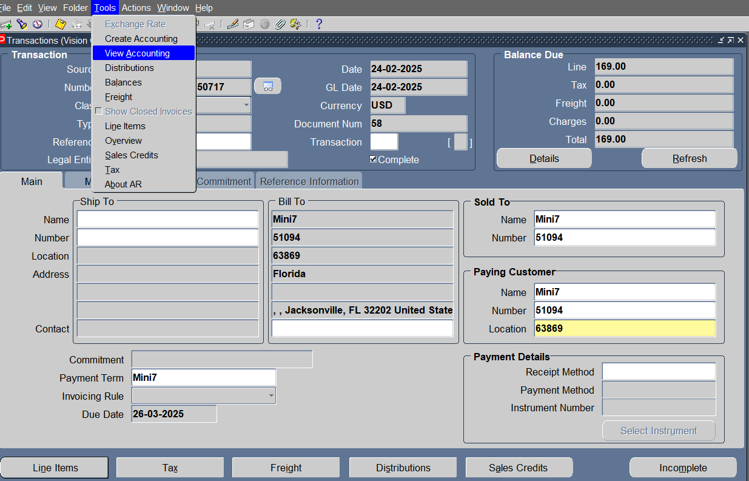
View accounting entry

Slide 36
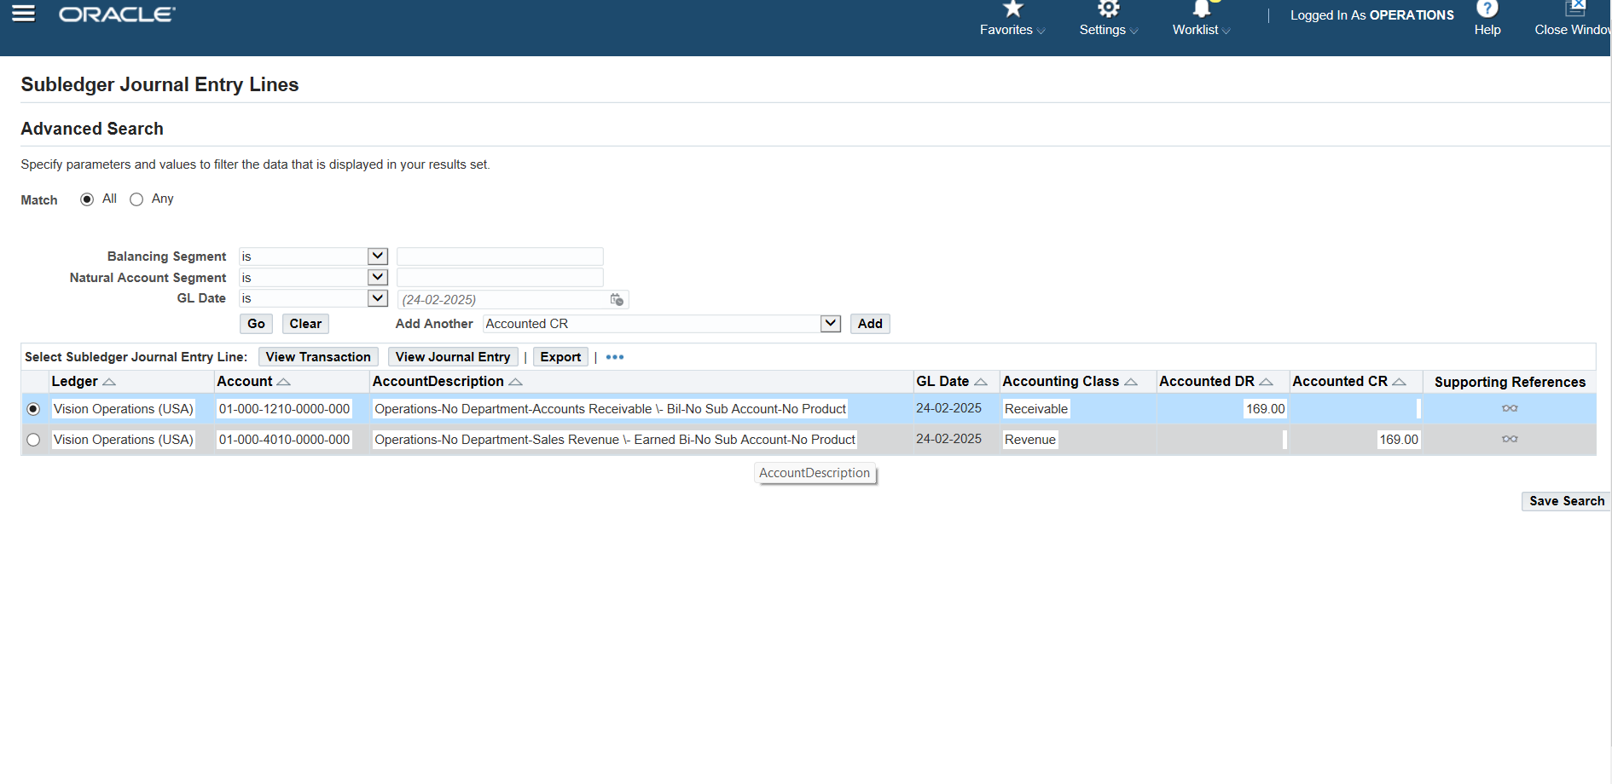
Transaction’s journal entry

Slide 37
Making cash invoice
Transactions<<< Transactions

Slide 38

Enter Customer Info ,transaction class its type , receipt method & tap line items to add transaction line

Slide 39
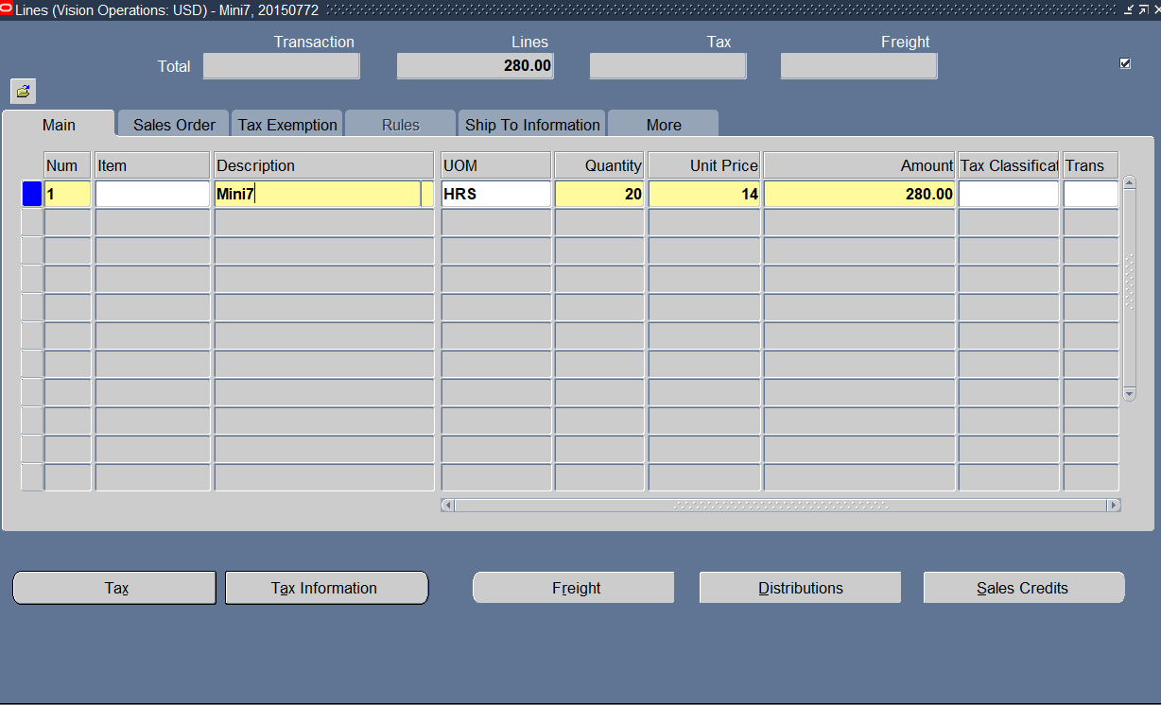
Add Transaction Line

Slide 40
Complete this transaction

Slide 41

Transaction entry completed & we have a transaction number

Slide 42
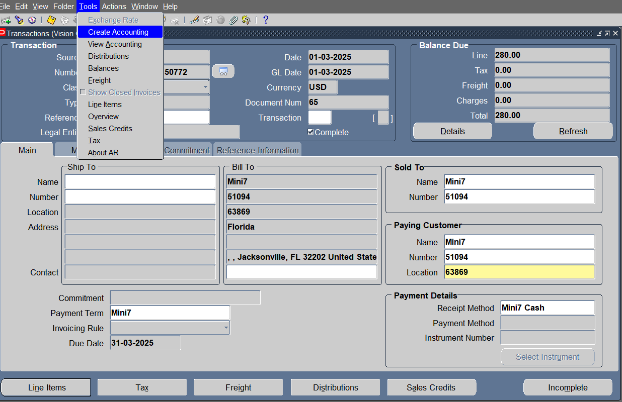
TOOLS> Create accounting

Slide 43
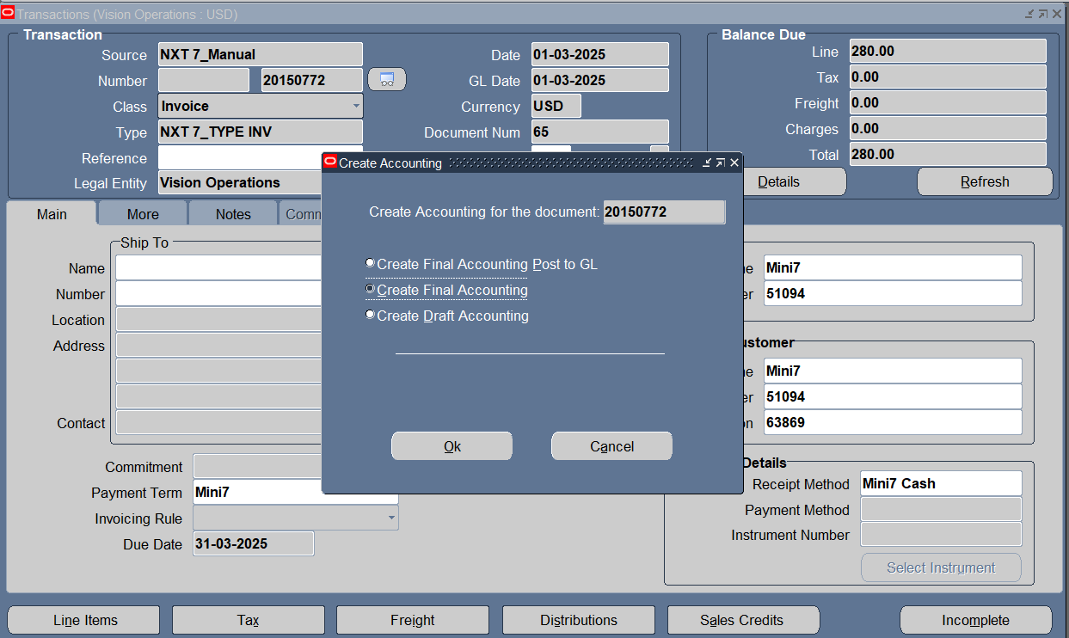
Create Final Accounting

Slide 44
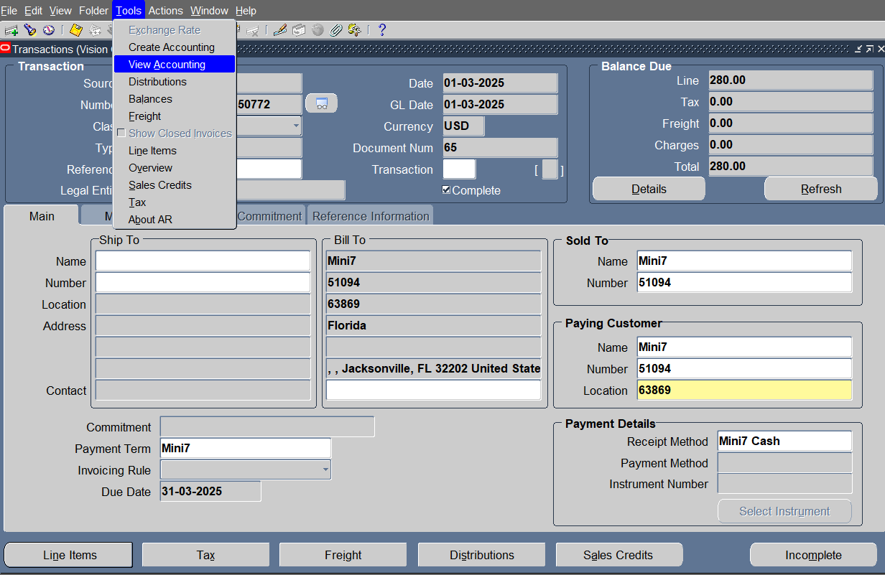
TOOLS >View accounting

Slide 45
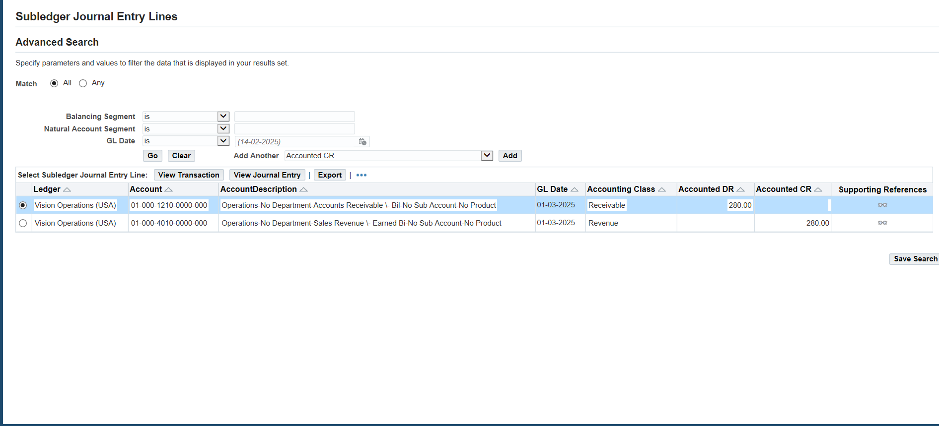
Transaction’s journal entry

Slide 46
Applying credit ON debit

Slide 47
Making debit memo
Transactions<<< Transactions

Slide 48
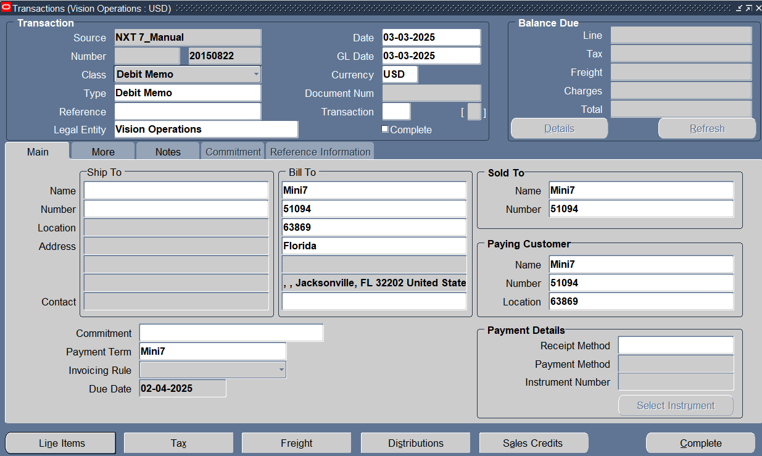
Enter Customer Info ,transaction class its type & tap line items to add transaction line

Slide 49
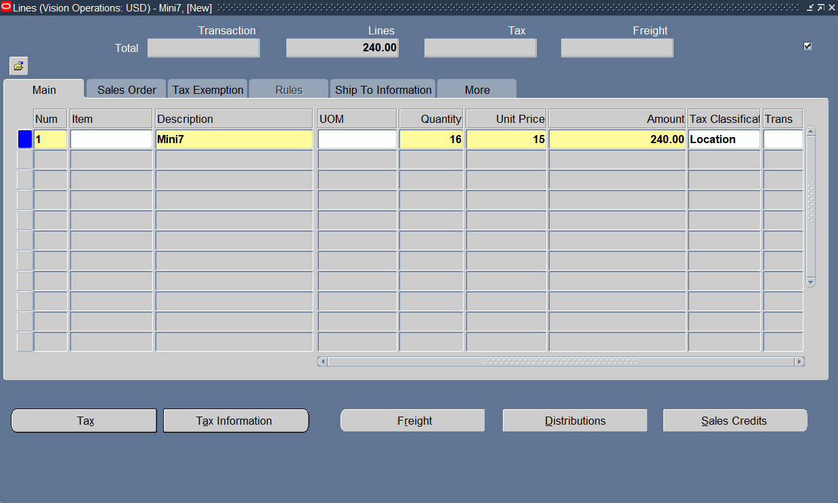
Add Transaction Line

Slide 50
Complete this transaction

Slide 51
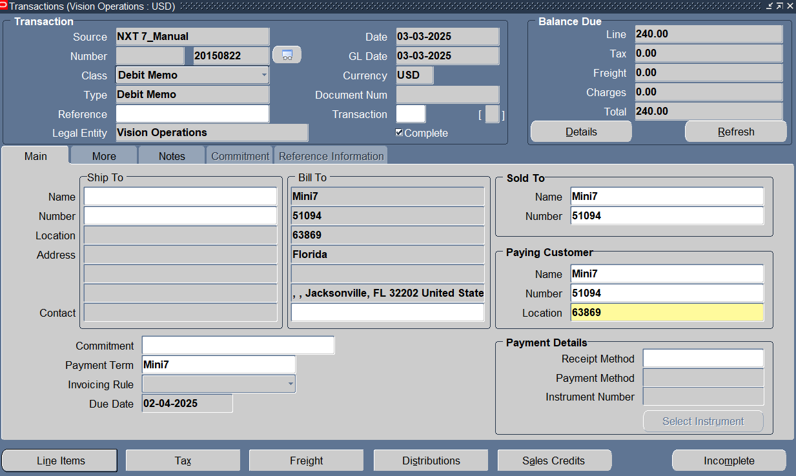
Transaction entry completed & we have a transaction number

Slide 52
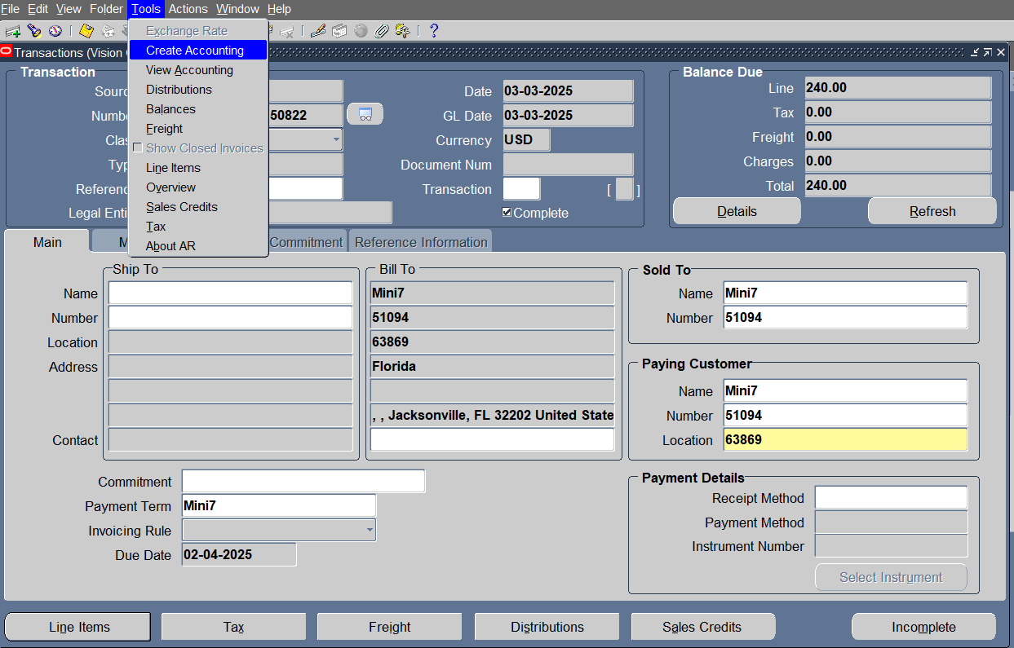
TOOLS> CreatE accounting

Slide 53
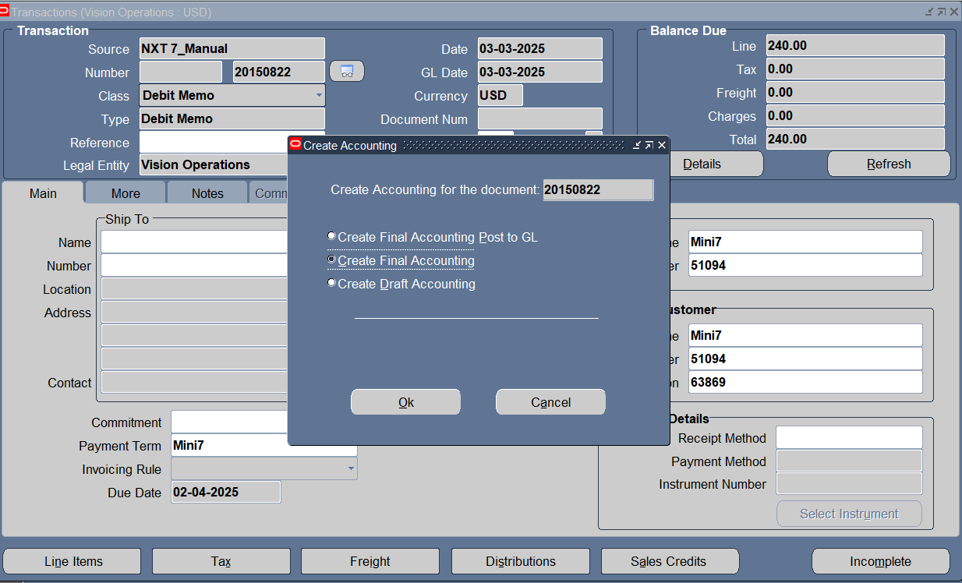
Create Final Accounting

Slide 54
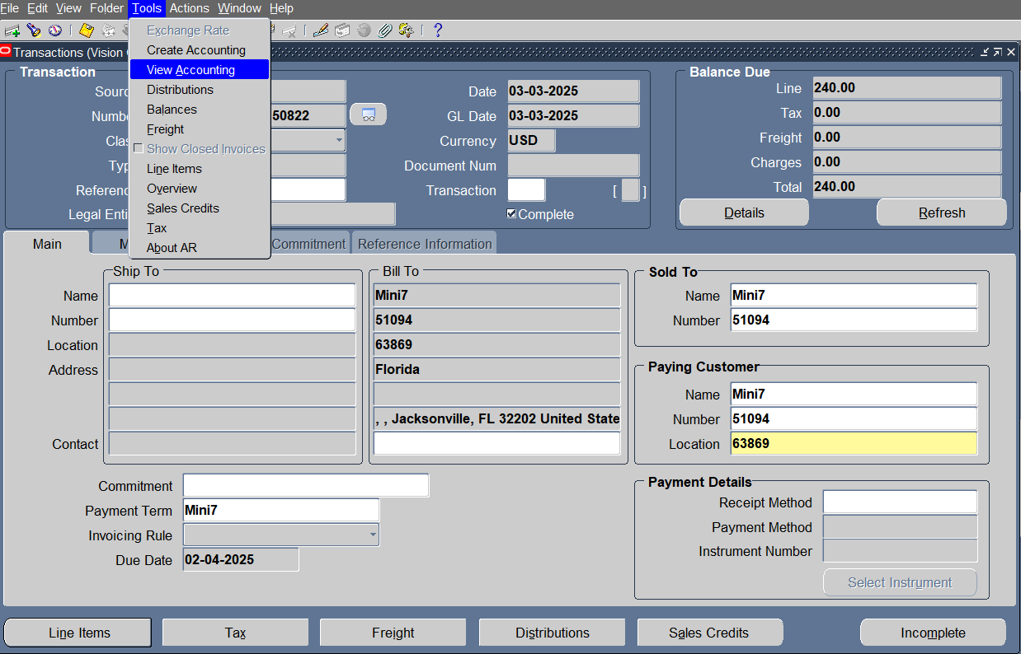
TOOLS >View accounting

Slide 55
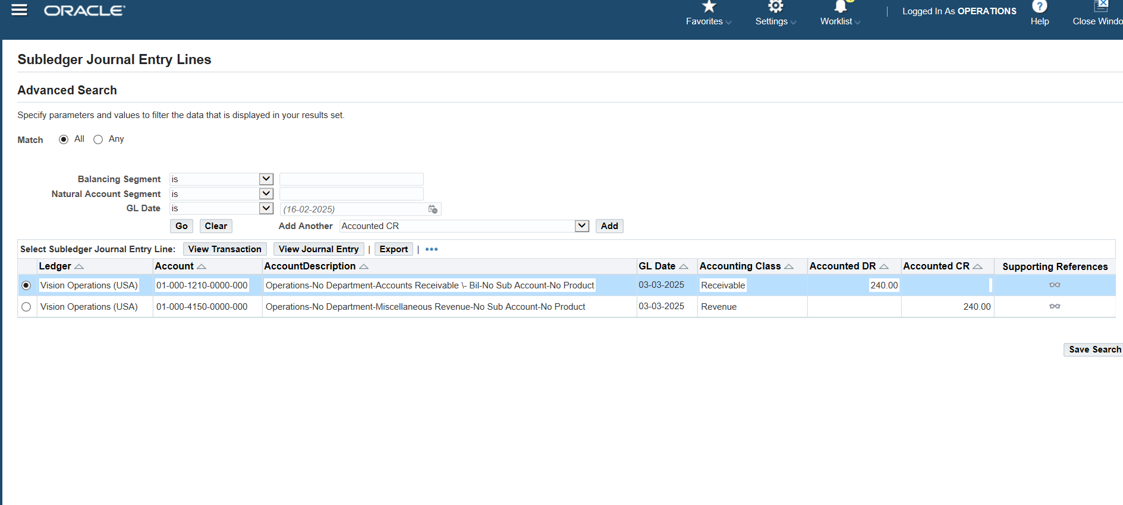
Transaction’s journal entry

Slide 56
Making credit memo
Transactions<<< Transactions

Slide 57
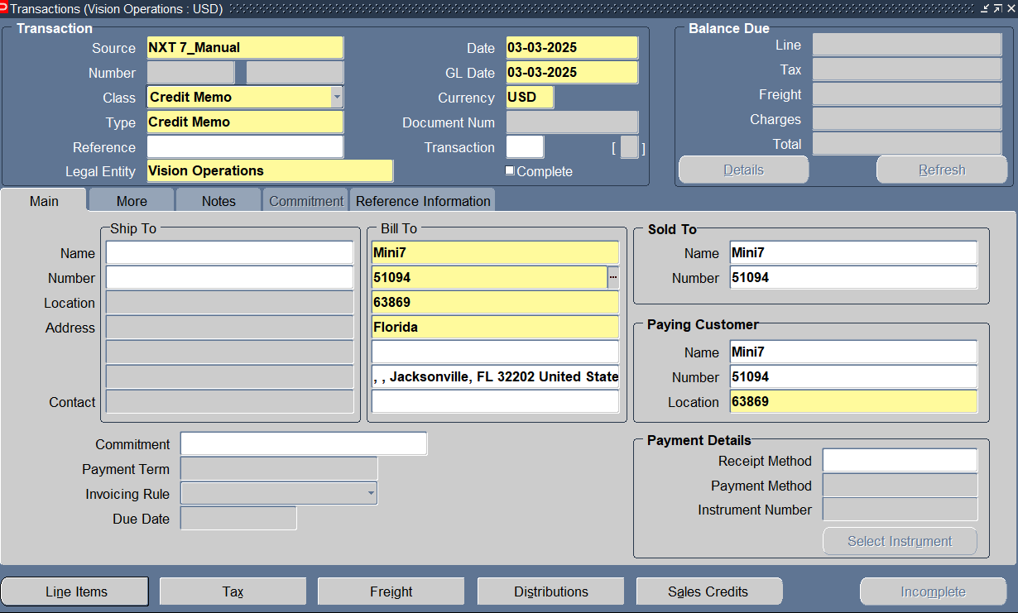
Enter Customer Info ,transaction class its type & tap line items to add transaction line

Slide 58
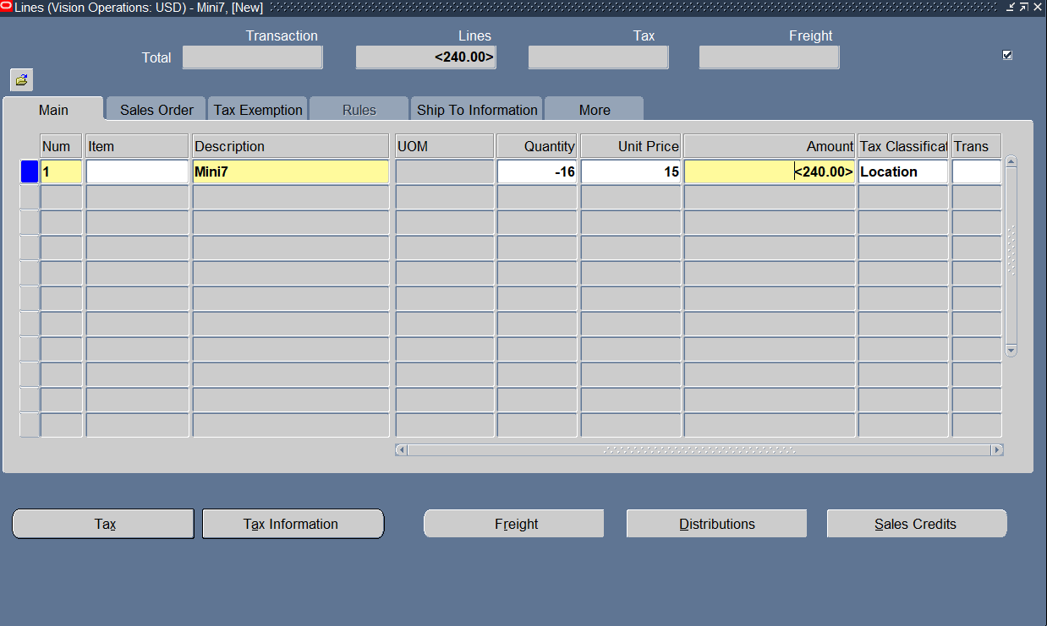
Add Transaction Line

Slide 59
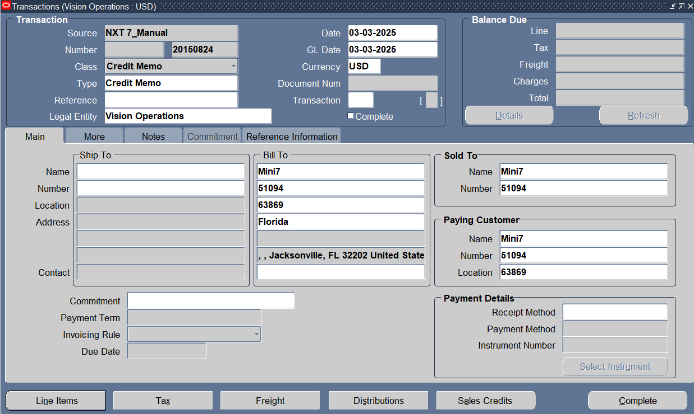
Complete this transaction

Slide 60
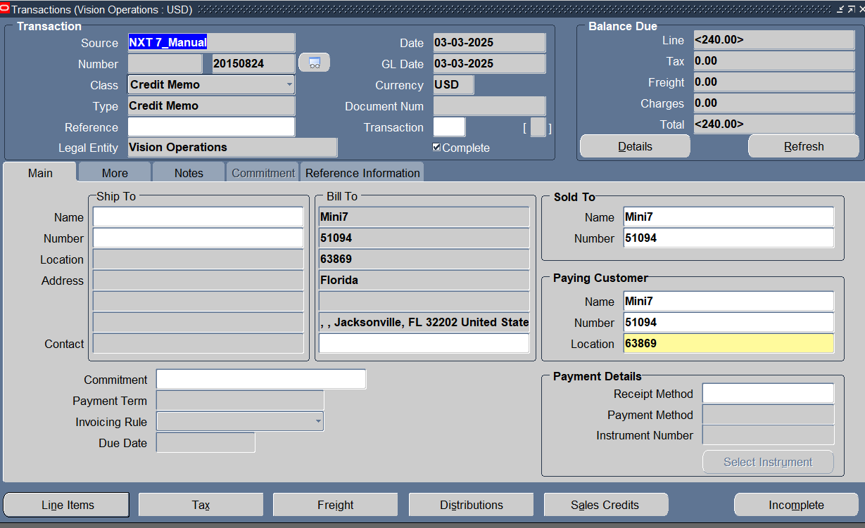
Transaction entry completed & we have a transaction number

Slide 61
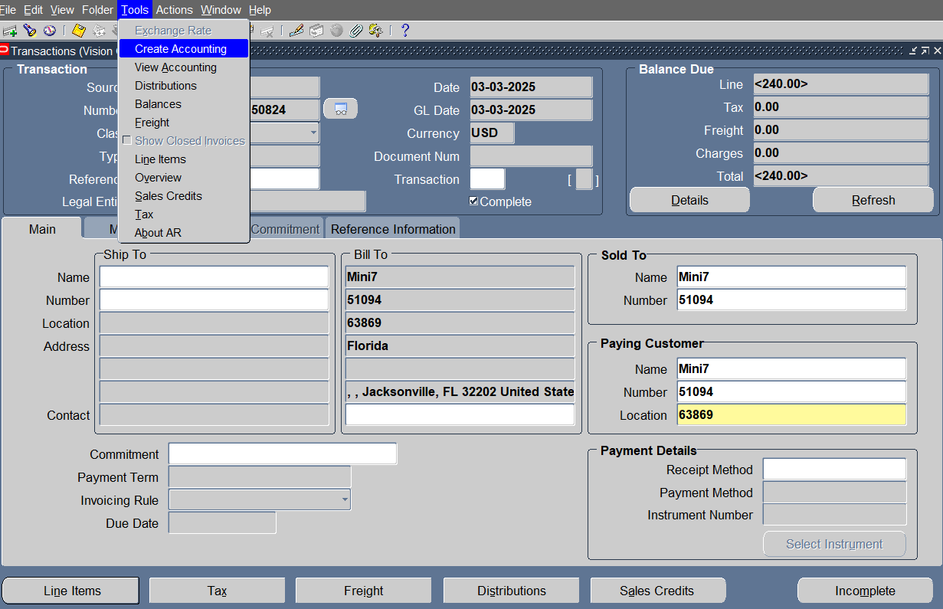
TOOLS > CreatE accounting

Slide 62
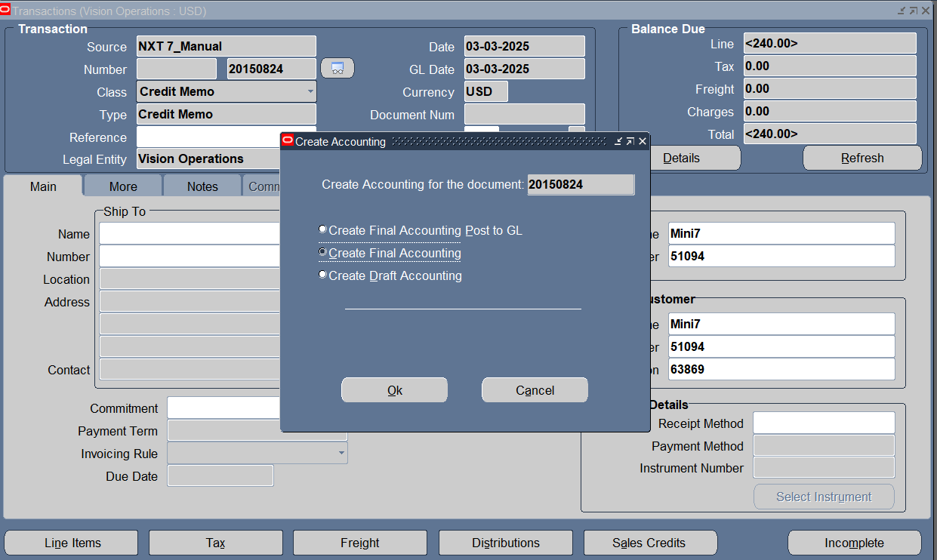
Create Final Accounting

Slide 63
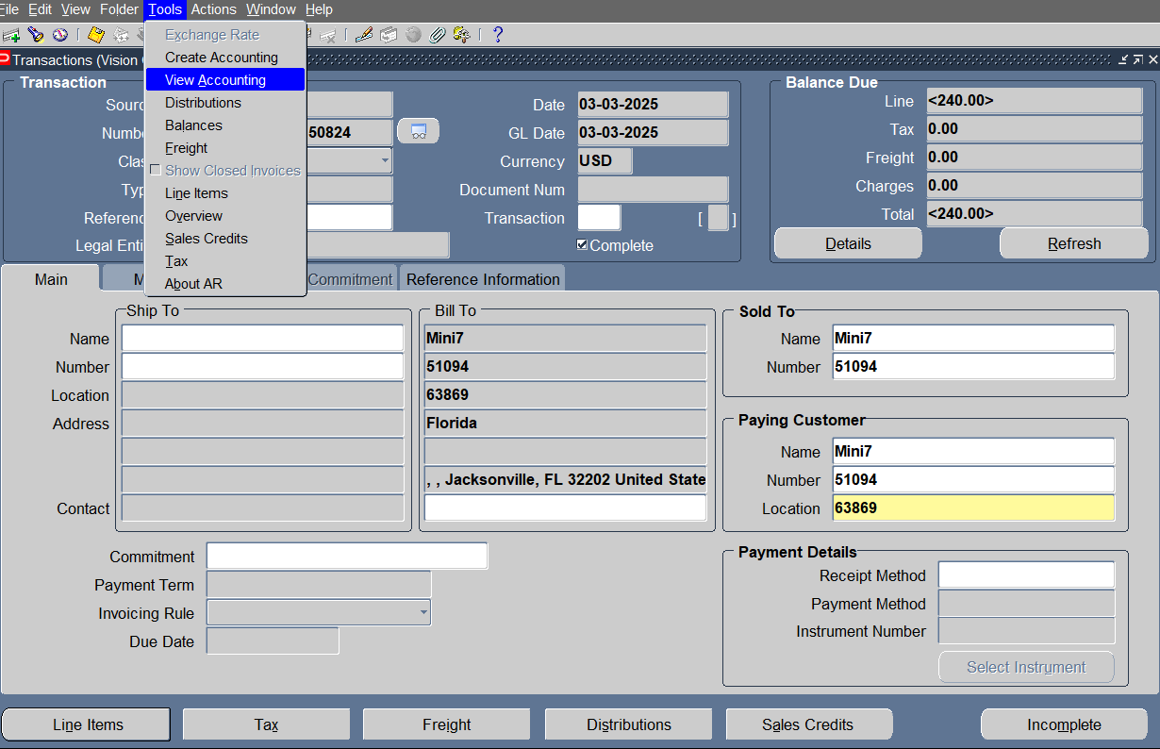
TOOLS > View accounting

Slide 64
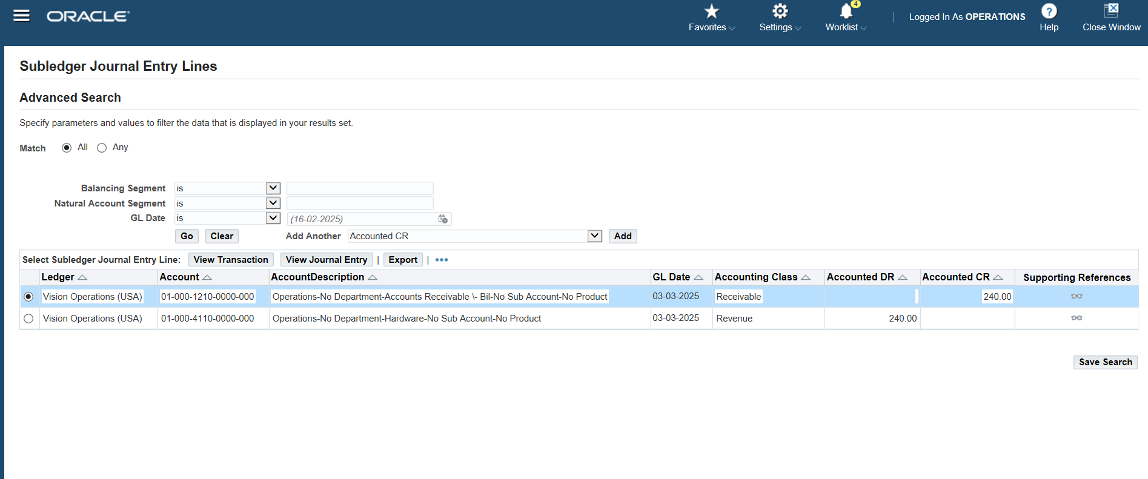
Transaction’s journal entry

Slide 65
Applying debit ON credit

Slide 66
Making credit memo
Transactions<<< Transactions

Slide 67

Enter Customer Info ,transaction class its type & tap line items to add transaction line

Slide 68
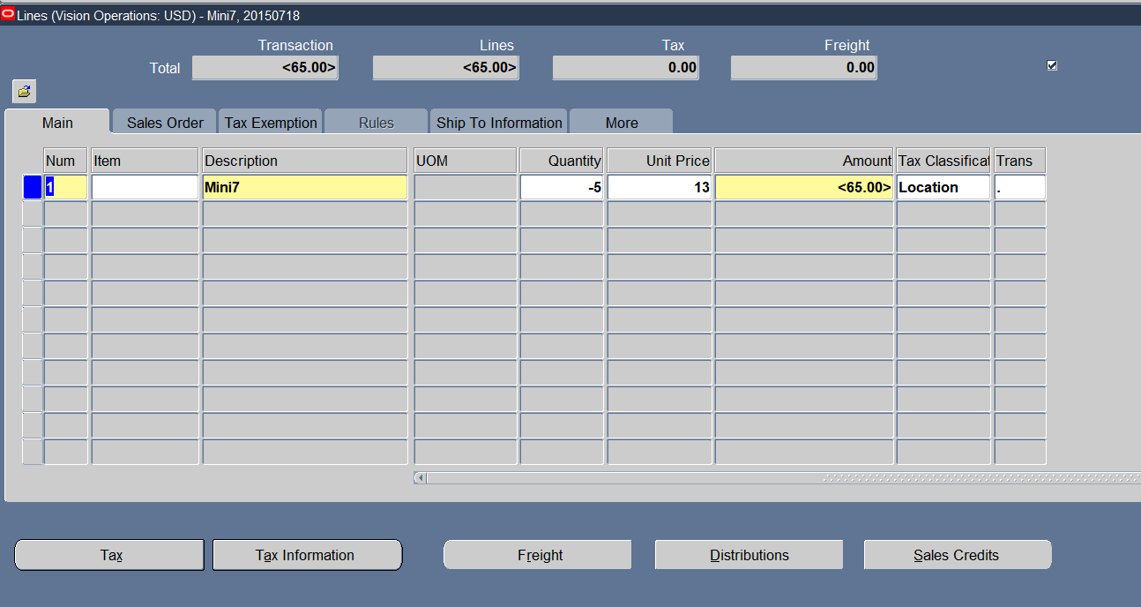
Add Transaction Line

Slide 69
Complete this transaction

Slide 70

Transaction entry completed & we have a transaction number

Slide 71

TOOLS> Create accounting treatment

Slide 72

Creating Final Accounting

Slide 73

TOOLS> View Accounting

Slide 74

Transaction’s journal entry

Slide 75
Making Debit memo
Transactions<<< Transactions

Slide 76

Enter Customer Info ,transaction class its type & tap line items to add transaction line

Slide 77

Add transaction Line

Slide 78
Complete this transaction

Slide 79

Transaction entry completed & we have a transaction number

Slide 80

TOOLS> Create accounting treatment

Slide 81

Create Final accounting

Slide 82

TOOLS> View AccountiNG

Slide 83

Transaction’s journal entry

Slide 84
Making Deposit
Transactions<<< Transactions

Slide 85

Enter Customer Info ,transaction class & its type

Slide 86

Enter commitment info

Slide 87

TOOLS >Create accounting treatment

Slide 88

Create Final Accounting

Slide 89

TOOLS> View Accounting

Slide 90

Transaction’s journal entry

Slide 91
Applying Deposit on standard
Transactions<<< Transactions

Slide 92
Enter Customer Info ,transaction class its type & tap line items to add transaction line

Slide 93

Add transaction Line

Slide 94

Transaction entry completed & we have a transaction number

Slide 95

Applying deposit on invoice ACTIONS> APPLY DEPOSIT

Slide 96

Enter the deposit info

Slide 97

The deposit was added and adjusted

Slide 98

The final balance

Slide 99

Tools> Creating accounting

Slide 100

Creating final accounting

Slide 101

TOOLS > View Accounting

Slide 102

Transaction’s journal entry

Slide 103

Enter an invoice with items Transactions>>Transactions

Slide 104

"Enter the customer name, currency, Date, invoice type, and payment term." Press Line Items

Slide 105

"Enter '%%' in the Items field, press OK, and select the items."

Slide 106

Set the quantity for the item Specify the unit price of the item

Slide 107

Press complete

Slide 108

To Make this Invoice complete and transfer to the General ledger Tools >Create Accounting

Slide 109

Crate final Accounting >>Ok

Slide 110

To show The transaction for this invoice Press Tools >> View Accounting

Slide 111

"Accounts receivable will be recorded as a debit, while revenue will be recorded as a credit."

Slide 112

the same steps as before to enter the invoice Transactions>>Transactions

Slide 113

"Enter the customer name, currency, invoice type, and payment term." Press Line Items To Select Which Type of line items I Enter in This Invoice
v
v
v
v
v
v

Slide 114

Enter the Type of line Items and amount
v
v

Slide 115

Press Complete
v

Slide 116

To Make this Invoice complete and transfer to the General ledger Tools >Create Accounting

Slide 117

Crate final Accounting >>Ok
v
v

Slide 118

Tools > View Accounting

Slide 119

Show thetransaction for this invoice "Accounts receivable will be recorded as a debit, while revenue will be recorded as a credit."
v

Slide 120
Invoice Adjustments

Slide 121

Adjustment Any Invoices: 1. Enter the Approval limit: Setup>>Transactions >>Approval limit

Slide 122

Add a new approval limit so I can adjust invoices
v

Slide 123

v

Slide 124

Enter Receivable Activities to manage adjustments Press Setup>>Receipts>>Receivable Activities

Slide 125

Enter the Operating unit, Name, Type, and then Enter the Code Combination
v
v
v
v
v

Slide 126

Search for invoices to adjust Transactions >> Transactions Select the Invoice and adjust it

Slide 127

Enter the Transactions Number and press find
v

Slide 128

Actions > Adjust

Slide 129

Select That Invoice I need to Adjust And Press Adjust
v
v

Slide 130

Select the Activity Name I entered in Receivable Activities, type, and the amount I need to adjust.
v
v
v

Slide 131

create accounting on the adjustment screen. Press Tools >> Create Accounting

Slide 132

Create Final Accounting>>Ok
v
v

Slide 133

Tools >View Accounting

Slide 134

show impacts on the customer’s account balance. Record the adjustment as a debit because it reduces the invoice by the same amount. This also decreases the receivables, which should be reflected as a credit
v

Slide 135

Press Details
v
v

Slide 136

show the adjustments that happened in the invoice
v
v
v

Slide 137
Search for another invoice to adjust Transactions > Transactions Select the Invoice and adjust it

Slide 138

Enter the Transactions Number and press find
v

Slide 139

"I will adjust to add an amount to the customer's invoice." Actions >> Adjust

Slide 140

Select the Activity Name I entered in Receivable Activities, type, and the amount that I need to adjust
v
v
v

Slide 141

And create accounting on the adjustment screen. Tools > Create Accounting

Slide 142

Create Final Accounting>>Ok
v
v

Slide 143

Tools >View Accounting

Slide 144

show impacts on the customer’s account balance. "Record the adjustment as a credit because it increases the invoice by the same amount. This also increases the receivables, which should be reflected as a debit."
v

Slide 145

Press Details
v
v

Slide 146

show the adjustments that happened in the invoice
v
v
v

Slide 147
CREATE BANK

Slide 148

Create Bank
Setup
Payment
Bank and Bank Branches

Slide 149

Create

Slide 150

Create New Bank

Slide 151

Create Bank Branch

Slide 152

Create account

Slide 153

Create bank account Setup > payment > bank account

Slide 154

create

Slide 155

Search with bank name > continue

Slide 156

vision operations > receivables > next

Slide 157

Add account name and number

Slide 158

Add cash & cash clearing accounts

Slide 159

Continue

Slide 160

Add Accounts, Apply

Slide 161


Slide 162
Create bank saFe box

Slide 163
Create Bank saFe box
Setup
Payment
Bank and Bank Branches

Slide 164

create

Slide 165

Create New Bank

Slide 166

create

Slide 167

Create bank branch > create

Slide 168

Search with bank name > continue

Slide 169

Create new Branch

Slide 170

Our bank branch is done

Slide 171
Create bank account Setup > payment > bank account

Slide 172
create

Slide 173
Search with our bank name

Slide 174

Create Bank account

Slide 175

Add account name & number

Slide 176

Add cash & cash clearing accounts

Slide 177

Save and next

Slide 178

Click continue

Slide 179

Add accounts & apply

Slide 180

Here is our bank

Slide 181


Slide 182

Receipt classes

Slide 183

Setup > receipts > receipt classes

Slide 184

We name receipt class and receipt method

Slide 185

We Link our Bank and add all accounts then we save

Slide 186
Setup > receipts > receipt classes

Slide 187

We name receipt class and receipt method

Slide 188

We Link our Bank and add all accounts then we save

Slide 189

Receipt : From menu Receipts choose function Receipts

Slide 190

Choose receipt method ,date , amount and customer name then click apply

Slide 191

Choose the invoices then ctrl+s to save them then click apply in detail

Slide 192

tools >create accounting

Slide 193

create final accounting then tools > view accountig

Slide 194

From tools choose view accounting

Slide 195

To change the State of receipts from CONFIRMED to REMITTED Click Receipts >> Remittances

Slide 196

Enter the batch and GL dates, select the receipt method and receipt class, and then enter the bank details, including the branch and account number where the funds were received. click Manual Create

Slide 197

Press Ctrl + F11 to search for the receipts you want to remit. Click on Format to finalize the remittance details

Slide 198

Click Yes

Slide 199

Receipts > Receipts

Slide 200

Search for the receipt

Slide 201

You will find that the State has been updated to REMITTED

Slide 202

TOOLs > Create Accounting

Slide 203

Create final accounting >> ok

Slide 204

Tools > view accounting

Slide 205

"Initially, when receipts are applied to an invoice, the journal entry is recorded as Confirmed Cash (Debit) and Receivables (Credit). Once transferred to remittance, the entry updates to Remitted Cash (Debit) and Confirmed Cash (Credit)."

Slide 206
remmetince receipts

Slide 207

From responsibility Receivable choose menu receipt

Slide 208

From menu Receipt choose function Receipt

Slide 209

Choose payment method

Slide 210

Determine the receipt amount & Determine the customer and the date Then click apply

Slide 211

Choose the invoice to be applied

Slide 212

After applying the invoices ctrl+s to save work

Slide 213

From tools Click create account

Slide 214

Choose create final accounting

Slide 215

Then click view accounting from tools

Slide 216

Journal Entry

Slide 217
cash receipts

Slide 218

Determine the receipt amount & determine the customer and the date then click apply

Slide 219

Select the invoices

Slide 220


Slide 221

From tools choose create accounting

Slide 222

Choose create final accounting

Slide 223

Choose view accounting

Slide 224


Slide 225
on account

Slide 226

receipts-->receipts

Slide 227

Choose receipt method ,date , amount and customer name then click apply

Slide 228

Apply amount On Account Then Ctrl+S to save

Slide 229

TOOLS > create accounting

Slide 230


Slide 231

To change the state of receipts from CONFIRMED to REMITTED click receipts >> remittances

Slide 232

Enter the batch and GL dates, select the receipt method and receipt class, and then enter the bank details, including the branch and account number where the funds were received. Click manual create

Slide 233

Press ctrl + F11 to search for the receipts you want to remit. Click on format to finalize the remittance details

Slide 234

You will find that the state has been updated to REMITTED

Slide 235


Slide 236
REFUND

Slide 237
Receipts > receipts

Slide 238

Choose receipt method ,date , amount and customer name then click apply

Slide 239

Choose the invoices then ctrl+s to save them then click apply in detail

Slide 240

Then to Make a refund we go to apply again

Slide 241

Apply amount to refund then ctrl+s to save then click on refund attributes to select money refund method

Slide 242

Then we choose to pay with checks then we click on apply

Slide 243

Unapplied amount turns negative

Slide 244

Then we create account

Slide 245


Slide 246

Payables > invoices

Slide 247

We got a payment request with the same amount of refund then we click Actions to create account

Slide 248

Create account >>final

Slide 249

Requests > view accounting

Slide 250


Slide 251
“write off”

Slide 252

Enter approval limits setup>>Transactions>>Approval limits

Slide 253

add a new approval limit for receipt write-off

Slide 254

Enter Receivables activities Setup > Receipts > Receivable Activities

Slide 255

In the Receivable Activities section, enter the Name and select the Type

Slide 256

"Input the Code Combination, then specify the Bad Debts account."

Slide 257

After entering the details, click Save to store the information

Slide 258

Next, navigate to Receipts to process the write-off for the outstanding amount. Receipts >> Receipts

Slide 259

"Entering the receipt details requires the following information: Receipt Method, Receipt Number, Receipt Amount, Customer, and Receipt Date.“ click 'Apply'

Slide 260

"After clicking 'Apply,' I select 'Receipt Write-Off' from the 'Apply To' field, then enter the Apply Date and GL Date."

Slide 261

"From the 'Activity' field, I select the Write-Off Name that was entered in Receivable Activities.“ And Save

Slide 262

“I will find that the amount is now marked as applied. Tools > Create Accounting

Slide 263

Create final accounting >> ok

Slide 264

Tools > view accounting

Slide 265

"I will see that the Write-Off journal entry has been generated, where Unapplied is debit and Write-Off is credit."

Slide 266
inquiry

Slide 267

Select Inquiry > Account details
Inquiry

Slide 268

Write customer name then click find

Slide 269

1.Click details when invoice appears 2.click activities to see actions done on the invoice. 3.The balance will appear at functional if the same currency other wise will appear at entered

Slide 270


Slide 271
aging

Slide 272

Receivables vision operations (usa)

Slide 273

Setup > collections> Aging Buckets

Slide 274

create aging > add our name and payments terms

Slide 275
CLEARING

Slide 276

Clearing
Transfer to cash management

Slide 277

Bank statements>manual clearing> clear transaction

Slide 278

Choose Ar Receipt

Slide 279

Choose our account> find z

Slide 280


Click to receipt that we will clear > CHANGE DATE

Slide 281

CLEAR TRANSACTIONS

Slide 282

TRANSFER TO RECEIVABLE RECEIPTS> RECEIPTS

Slide 283


ADD OUR RECIEPT METHOD, AMOUNT AND CUSTOMER NAME > APPLY

Slide 284

APPLY

Slide 285

TOOLS > CREATE ACCOUNT

Slide 286


CREATE FINAL ACCOUNT

Slide 287

TOOLS> VIEW ACCOUNTING

Slide 288

JOURNAL ENTRY

Slide 289
Generate Financial Reports

Slide 290

View >> Requests

Slide 291

Click on Submit a new request

Slide 292

I enter the report named 'Transaction Register'

Slide 293

"I enter the GL date, currency, and batch source name."

Slide 294

Press Submit

Slide 295

"I click on 'Find' and will see that the report is completed."

Slide 296

"I click on 'View Output' to see the report results."

Slide 297

"I will find that this report shows the header, all types of invoices, and all the transactions that occurred for those invoices."

Slide 298


Slide 299

Submit a new request' to enter another report

Slide 300

Enter a report named 'Receipt Register’

Slide 301

Specify the GL date, currency, and customer name

Slide 302

Click on 'Submit' to run the request

Slide 303

Click on 'Find' to see that the report is complete

Slide 304

Click on 'View Output' to see the results of the report

Slide 305

I Will find that it shows the header for the receipts and the transactions that occurred for the receipts

Slide 306

Submit a new request' to enter another report

Slide 307

Enter a report named “Customer Listing-summary”

Slide 308

Enter Order by Customer, input the Customer Name, and select the Customer Number.

Slide 309

Click on 'Submit' to run the request

Slide 310

Click on 'Find' to see that the report is complete

Slide 311

Click on 'View Output' to see the results of the report

Slide 312

The Customer Listing Summary report provides a summarized view of customer details, including customer names, numbers, statuses, city, and state.

Slide 313
Extra Tasks

Slide 314

Create journal entries

Slide 315

Click new journal

Slide 316

Add lines then post

Slide 317

CLICK post

Slide 318

posted

Slide 319
REVERSE

Slide 320

Reverse with switch dr/cr

Slide 321
Post> posted

Slide 322

Reverse with change sign

Slide 323
AUTO COPY BATCH

Slide 324

Click auto copy batch

Slide 325

Click ok

Slide 326

post

Slide 327

Search for auto copy batch

Slide 328

Unposted> posted

Slide 329
Currencies (Daily Rates)

Slide 330

I will input a different currency into the system with a set exchange rate Setup>>Currencies>>Rates>>Daily

Slide 331

converting Currency(USD) to another Currency(EUR) " Defining currency conversions for journal transactions. I select the target currency, specify the exchange date and currency type, and then input the exchange rate and its equivalent value Press "Enter By Date Range"

Slide 332

Define the conversion period by selecting the From Date and To Date

Slide 333

Journals>> Enter

Slide 334

Enter the journal in EUR currency, select a date within the specified range, and choose the currency type. The system will automatically display the previously entered exchange rate. When entering the journal lines, specify the accounts and input the amount in EUR. The system will automatically display the equivalent amount in USD based on the predefined exchange rate.

Slide 335
“ Create Recurring Journals “

Slide 336

"Recurring journals are journal entries that are generated automatically every month with a fixed code combination, while the amount may vary. Additionally, a formula can be applied to calculate the amount dynamically based on predefined criteria." Press Journals >> Define>>Recurring

Slide 337

"To create a recurring journal batch, I first enter the batch name and select the recurring batch type. Then, I create and enter the journal, specifying the category, currency, and ledger." Press Lines

Slide 338

Enter all the journal lines, specifying the code combination and amount for each line

Slide 339

To enter a journal line and set it as a debit, I input the amount with a positive sign.

Slide 340

Enter Line 2 & Code Combination

Slide 341

If it's a credit, I enter the amount with a negative sign

Slide 342

Press Generate

Slide 343

Click Submit

Slide 344

"I enter the period and specify the journal effective date as well as the calculations effective date.“ Click submit

Slide 345

"I click 'Save' to run the request."

Slide 346

Click View>> select Requests to check the request status

Slide 347

Click Find to search for the request

Slide 348

The request will appear, showing that it is completed.

Slide 349

Journals>>Enter to review the journal

Slide 350

When Search To review the journal, I enter the batch details and specify the source as Recurring to indicate that it is a recurring journal entry

Slide 351

"Once the journal is displayed, click Review Journal to verify the entries, amounts, and account combinations before proceeding with the posting."

Slide 352

"After verifying that everything is correct, I proceed with posting the journal." Click Post

Slide 353

"Once the journal is posted, I run the request to process and confirm the posting in the system."

Slide 354

View>> Requests to check the request

Slide 355

"Once I check the request, it will show as 'Completed,' indicating that the process has been successfully executed." "After the request is marked as Completed, Click View Output

Slide 356

to review the generated report or verify the processed journal details."

Slide 357
closing period by gl

Slide 358

Closing period :from responsibility general ledger select setup menu

Slide 359

Select open/close function

Slide 360

Select the period

Slide 361

Select the status closed then ctrl save

Slide 362


Slide 363


Slide 364

From view choose requests

Slide 365

Press find button

